Slide 1
Understanding and Responding to Behaviours of Concern IPPN – February 2024

Slide 2
Sharon Healy Specialist Lead for Behaviour for Learning and Wellbeing

Slide 3
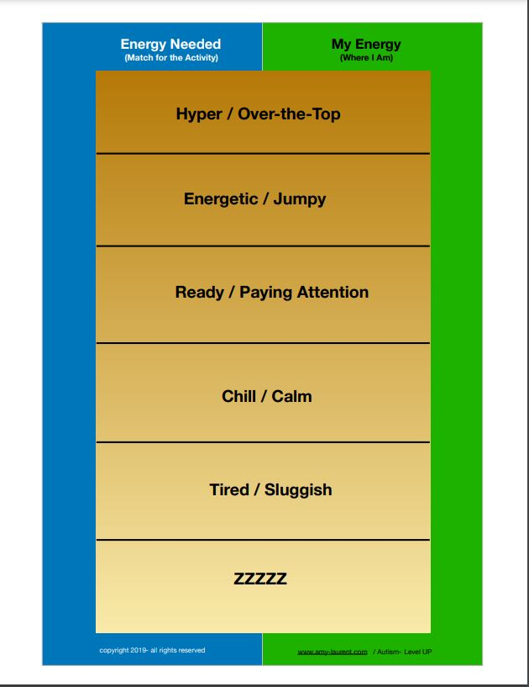

Slide 4
Behaviour – The Broader Context
TESS - Code of Behaviour review
NCSE - Behaviour Framework development
NEPS – Emotional and social difficulties review (Green Book)
Special Education – Understanding Behaviours of Concern and Responding to Crisis Situations
Department of Education – Cinealtas, Wellbeing Framework, Autism Good Practice Guidance

Slide 5
Goal Setting
10
What are your best hopes for behaviour in your school?

Slide 8
Ask Ourselves….
WHY?
WHY NOW?
Notes:
Key Message: Stuart Shanker encourages reflection on why a stress response is happening, and asking ourselves why it may be happening now.

Slide 9
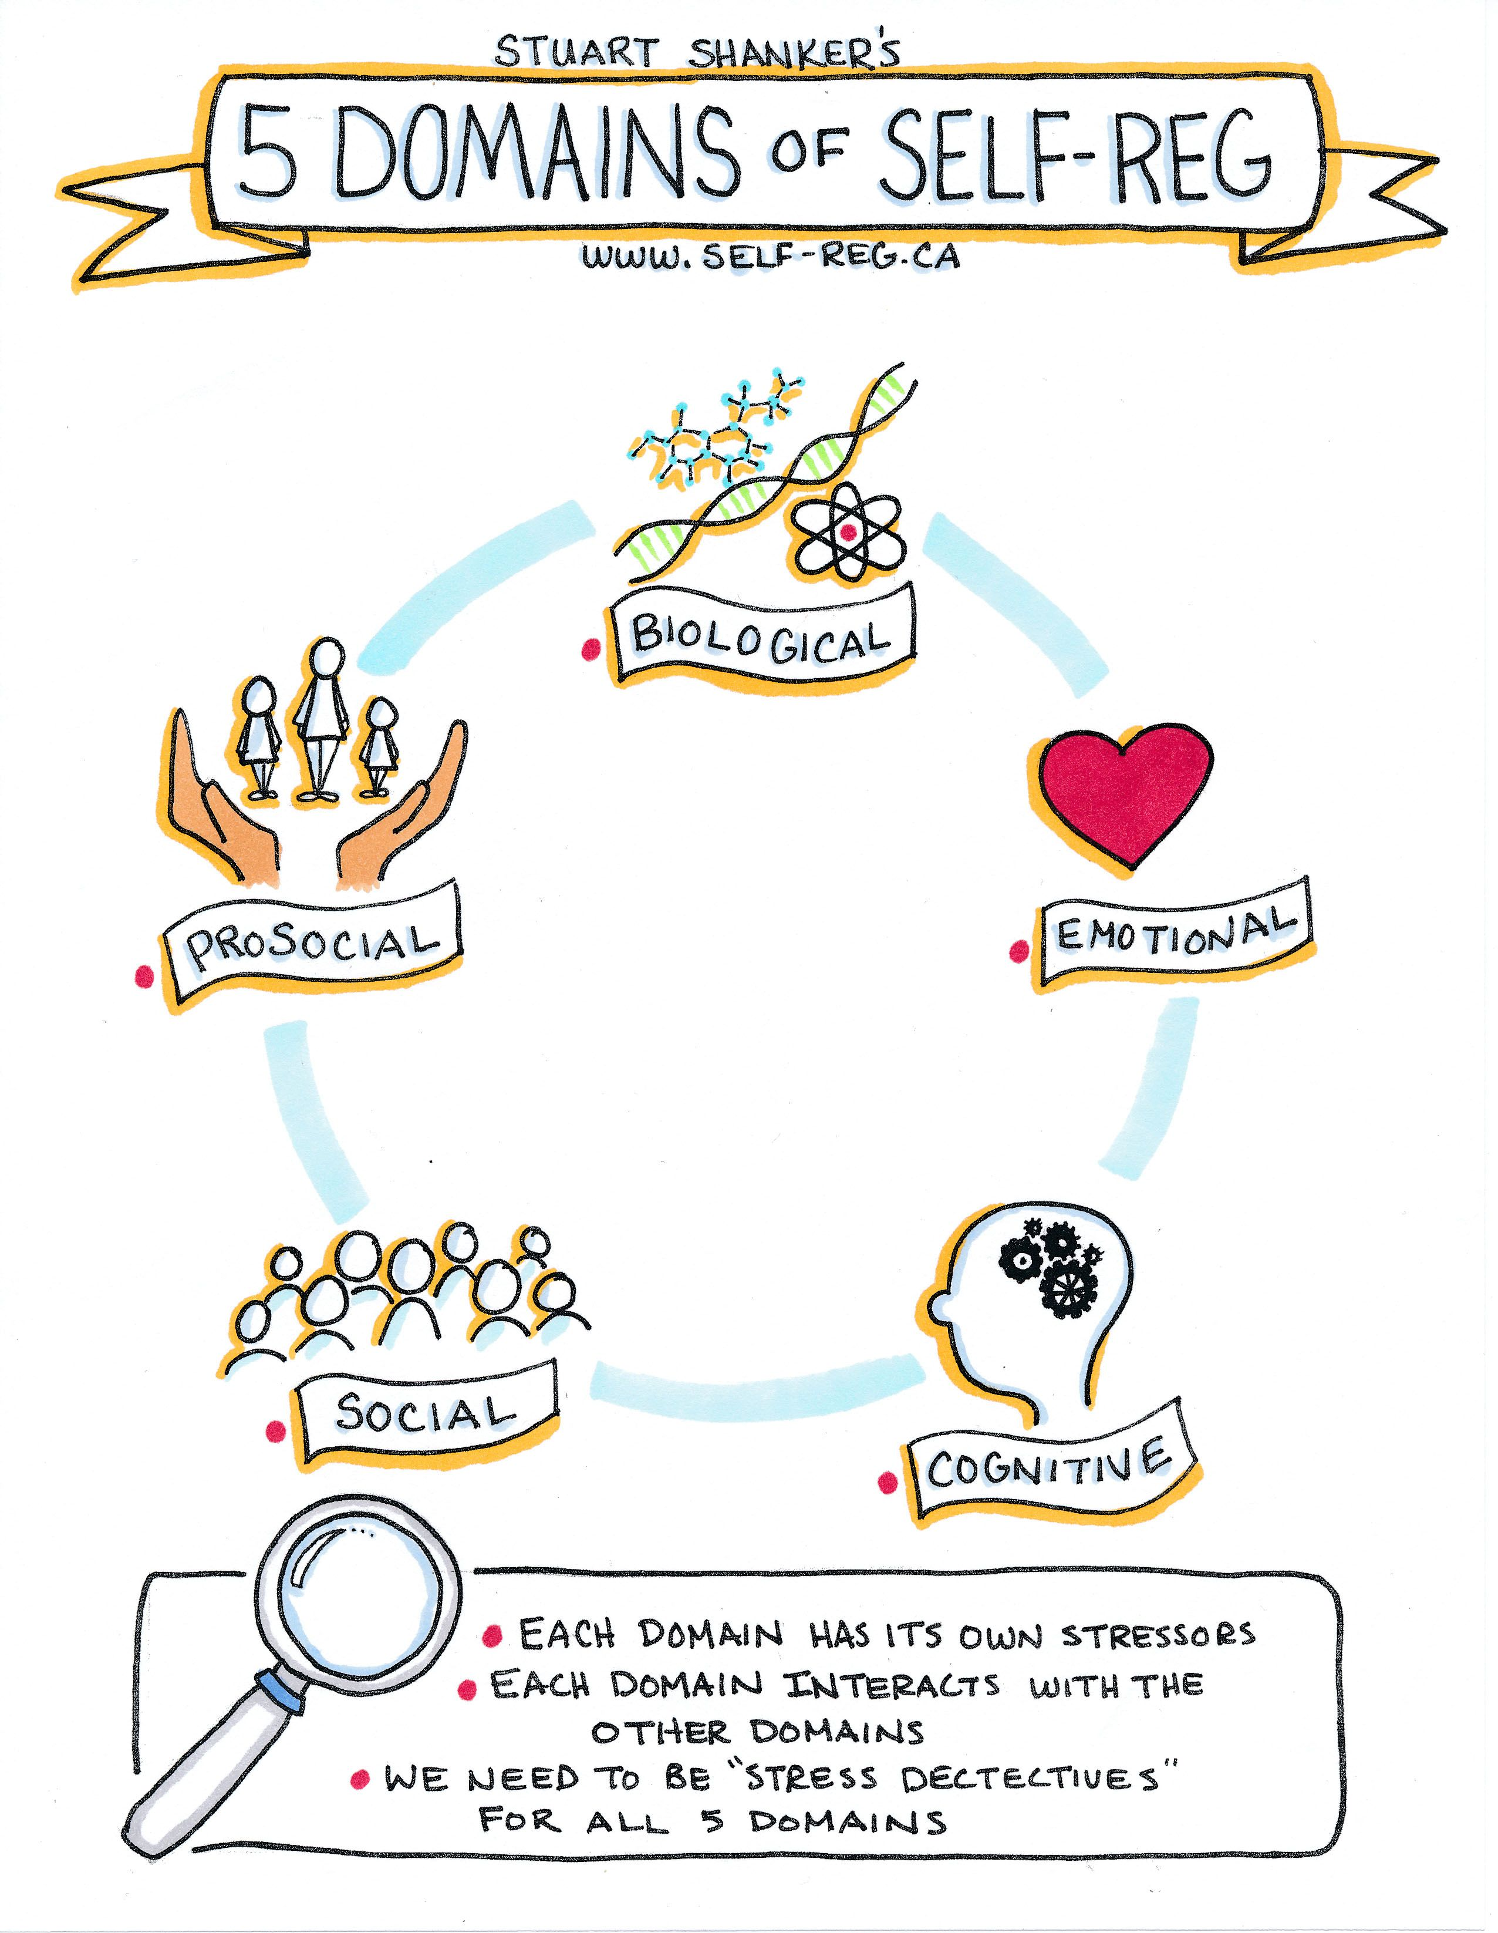
The Shanker Self-Regulation Framework Five Domains and Five Practices of Self-Regulation
Self-regulation refers to the manner in which an individual deals with stress, in all its many forms, and then recovers from the energy expended
Dr. Stuart Shanker and The MEHRIT Centre 2021
Notes:
Key message: The Shanker Self-Reg® Framework is a powerful method for understanding stress and managing energy flow. Self-Reg is not a program, but rather a practical paradigm through which parents and teachers can better understand children’s stress, and support their regulation.
Information to illustrate: Shanker’s Self-Reg Framework helps us consider self-regulation and stress across five interrelated domains: biological, emotion, cognitive, social and prosocial and details five practices to utilise the framework:
Reframe the behaviour
Recognise the stressors
Reduce the stress
Reflect and enhance stress awareness
Respond with personalised ways to support restoration and resilience.
During this session we will be looking at strategies to reduce the stress and reflect and enhance stress awareness.
Reference:
What You Need to Know. by Dr. Stuart Shanker : Self-Regulation: 5 Domains of Self-Reg

Slide 10
Notes:
Key message: The biological domain relates to stressors that affect ones physiological system which can result in dysregulation.
Information to illustrate:

Slide 11
Notes:
Key message: Emotional domain is the domain that includes strong emotions and both positive and negative emotions.

Slide 12
Notes:
Key message: Cognitive stress is caused by difficulty processing certain kinds of information.

Slide 13
Notes:
Key message: The social stressors relate to a person’s difficulty picking up on social cues and understanding the effect of their behaviour on others.

Slide 14
Notes:
Key message: Signs of prosocial stress.. Read the slide.

Slide 15
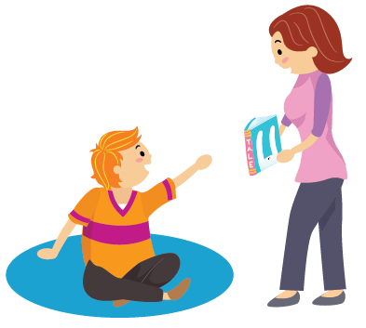
Prevalence of SLCN
10 % of children have Speech, Language and Communication Needs
50-60% of children in areas of social disadvantage have been assessed as having SLCN
7% have Developmental Language Disorder (DLD)
3% of SLCN is linked with other diagnoses such as Autism, Down Syndrome, General Learning Difficulty or who are deaf/ hard of hearing.
Notes:
Key message: Statistics re prevalence of SLCN.
Information to illustrate:
The prevalence of SLCN in schools is high.
- Internationally it is accepted that around 10% of the population have SLCN.
- In areas of social disadvantage, this figure is significantly higher with up to 50-60% of children entering school with SLCN.
- 7% of all children have a Developmental Language Disorder, which we will discuss in the next slide.
- At least 3% of all children have SLCN linked with other conditions, including those with Autism Spectrum Disorder, hearing impairment or specific learning difficulties. The majority of children with additional needs have some degree of SLCN.
SLCN are often under-identified in schools. Considering how common these needs are, it is important to think about how many students you might typically expect to present with SLCN in your school.
The support that teachers provide to children with SLCN can enable their access to the curriculum and their participation in all aspects of school life.

Slide 16
Research regarding Long Term Impacts of SLCN
Vocabulary skills upon entry to primary school are the predictor of literacy skills & learning (Law et al., 2010)
66% of males excluded from school have SLCN (Clegg et al., 2009)
Adolescent research in the Irish context 95% of students with behavioral difficulties presented with SLCN
46-67% of youth offenders have SLCN (Bryan et al., 2007)
Notes:
Key message: SLCN can have long term impacts for some of our students.
Information to illustrate: As we are more aware of the impact that SLCN can have on a child, it is important now to be mindful of the long term impact of SLCN and there is significant evidence of this
1 – at primary level if a child’s vocab skills are reduced on entry due to environment or SLCN this can be a predictor of overall school performance
2. – A study in the UK found that 66% of excluded males at post primary level had SLCN
3. – An Irish study found that 95% of post primary students receiving tier 3 support for behaviour had SLCN
4. – A study by Bryan et al 2007 found that SLCN was common in youth offenders. There is now a growing interest in Ireland abut the links between language and those in the prison system from a young age.

Slide 17
Key Aspects of Language and Communication
Notes:
Key message: These are the key aspects of language and communication for all. This infographic has been pulled from the Autism Good Practice Guidelines (DES, 2022) but is important for all. We will come back to strategies for each later.
Information for presenters:
This infographic has been pulled from the Autism Good Practice Guidelines (DES, 2022). As you can see there are 4 key aspects of language and communication of significance flagged here; attention, receptive language, expressive language and social/pragmatic language. Some students may have difficulties in all, some or one area of language.
Attention:
“Attention and listening skills are key components of social engagement, language development and group learning. Consideration should therefore be given to a student’s developmental stage of attention including their ability to display joint attention or share attention. Enjoyable and meaningful activities can embed positive memorable experiences of interaction and joint/shared attention for students…” (pg. 68, DES, 2022)
Receptive Language:
Can be defined as one’s ability to understand and comprehend spoke language that you hear or read. Almost all verbal instructions involve receptive language skills and this can be significantly difficult for many of our students. Many of our students may also find idioms or ambiguous commentary difficult to process and interpret.
Expressive Language:
Encompases verbal and nonverbal skills. While expressive language is for the most part seen as ones abaility to verbally communicate we must also take into account our students abilities to expressively communicate in ways that do not involve verbal language e.g., gestures, signs, picture exchange and written words.

Slide 18
Proactive Steps to Support Stressors

Slide 19
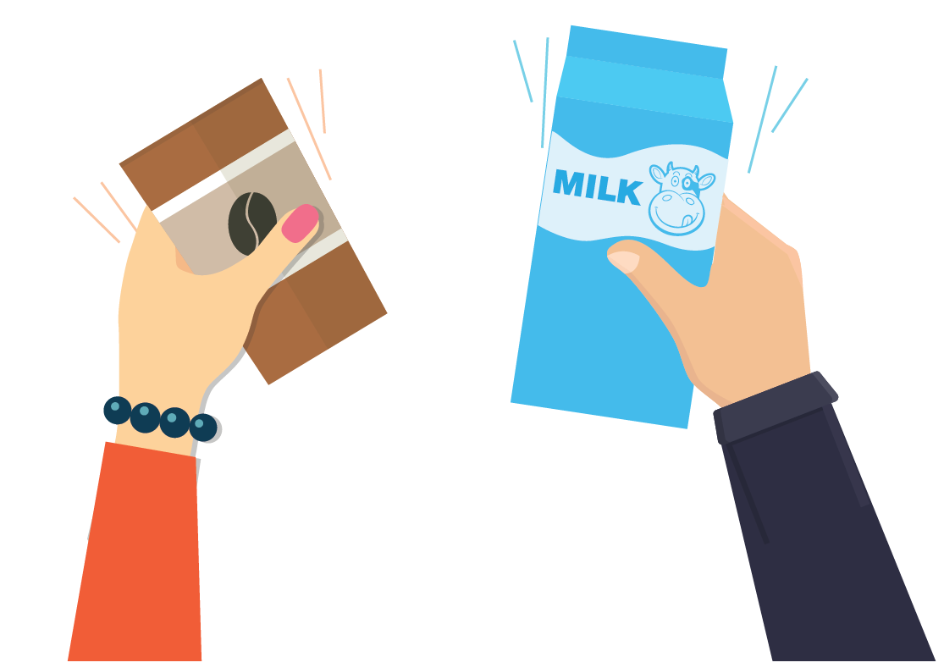
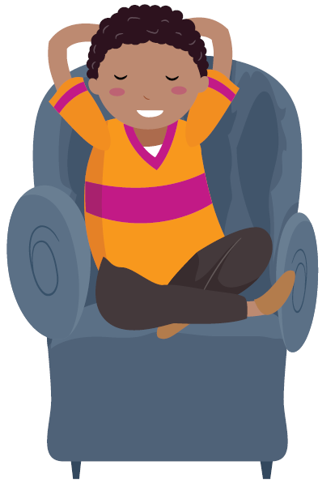
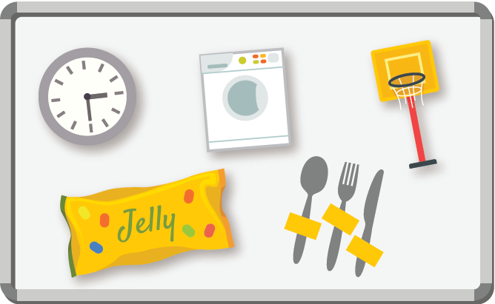
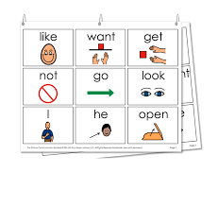
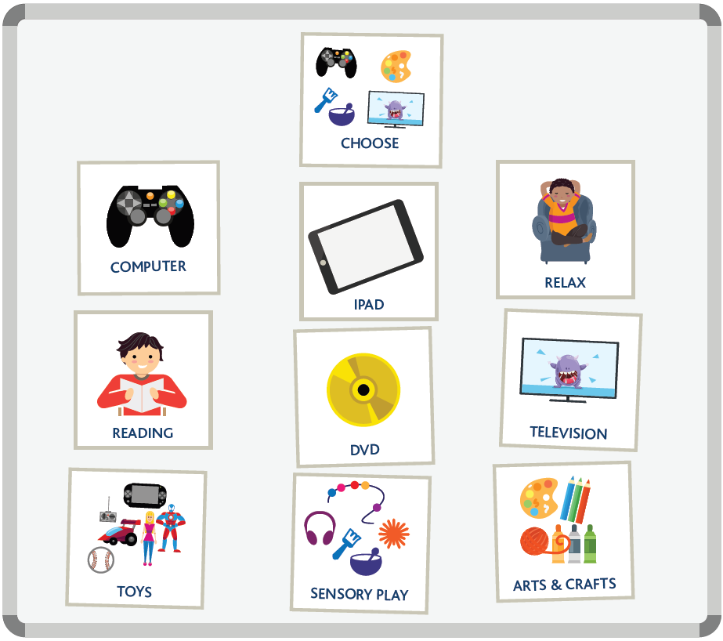
A Total Communication Approach
Body Language & Gestures
Objects
Pictures
Signals, Signs & Lámh
Notes:
Key Message: Quick overview and signpost to NCSE resource ‘A Total Communication Approach”. There is a video on Total Communication Approach to follow.
Considerations for mainstream also: In a classroom of 30 students, 2-3 students are likely to have Developmental Language Disorder (NCSE DLD Video) – Difficulties understanding langauge/ and or talking.
Embrace a total communication approach within the classroom. Adult’s role to match the communication mode of the student,
Providing opportunities for communication will ensure that students can convey information, explain thoughts, feelings and emotions. Students will feel listened to which promotes participation and engagement.
Embrace a total communication approach across whole school community:
Be sure that all staff are aware of the different communication needs within the school. Some students may use pictures, some may use sign, some may use gestures, objects, devices, etc. Remember that these are your students voice, and it is vital that we are all aware of the varying modes of communication used in the school. (Link to Culture and Enviornment Wellbeing Framework- Eliciting student voice)

Slide 20
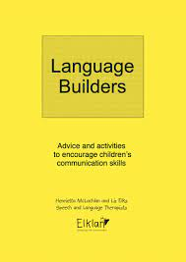
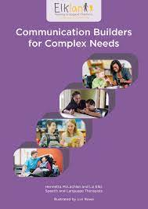
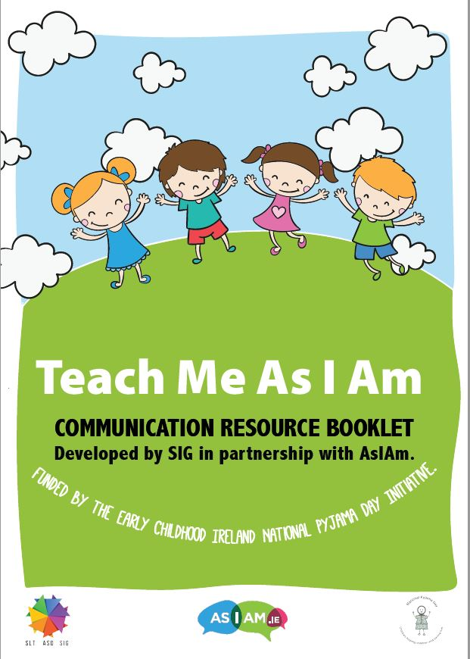
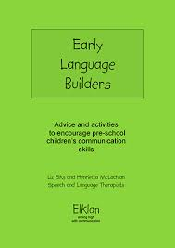
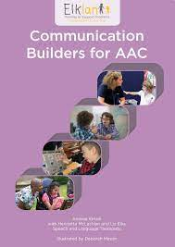
Helpful Resources
Notes:
Include Padlet QR code here also

Slide 21
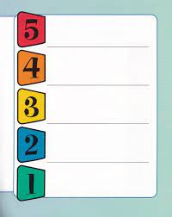
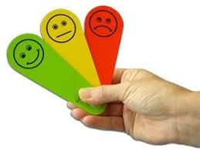
Varied Options for Functional Communication and Regulation
Notes:
Key Message: This is an explicit link to the prior Regulation and wellbeing section and some examples of Functional ways for students to communicate how they feel. Students who are verbal also need functional ways to communicate, relying on words alone when dysregulated can be very challenging. Consider how these systems can be modelled, used at whole class or individual level and plan for how they can be generalised across different settings. Systems will vary according to student profile and context.
Examples:
Visual Scales or Metres – 5 point scale / Autism Level up Energy Metre
Blob Trees : cartoon images representing different states,
Thumbs up/ thumbs down/ - concrete way, easily generalised and modelled at whole class level
Emotion fans
Take a break cards/ holding up a colour pen – to signal needing a break.

Slide 22
Implementing UDL through Proactive Strategies
Creating accepting and supportive environments
Optimizing individual choice and autonomy
Promoting flexible forms of communication
Rules, Routines and Expectations
Supports that increase predictability
Supports for executive functioning
Varying resources to optimize challenge
Notes:
Essential for some Beneficial for All

Slide 23
Consider Why School Might Be Stressful for Me?
Trusting Grown-Ups
Allowing others to take the lead
Feeling Safe
Managing sensory overload
Managing Multiple Transitions
Feeling that I belong
Taking the risks required when learning something new
(Bombér, 2007)
Notes:
Key message: Consider the asks of school from the position of the child. Read through the big asks for school from Louise Bomber 2007

Slide 24
Book Recommendation
Educators make a difference and their actions can be
life-changing

Slide 25
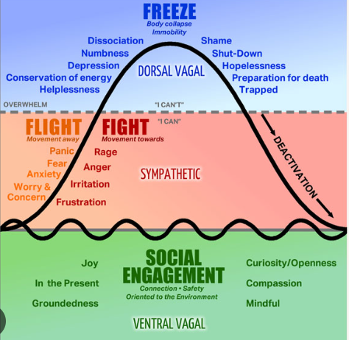
Responding – When and How?

Slide 26
Regulate, Relate, Reason
Notes:
Key message: Dr. Bruce Perry’s Regulate, Relate, Reason.
Information to illustrate:
Dr. Bruce Perry has developed a simple method for helping children and young people to learn, think and reflect. He refers to the importance of understanding brain structure when trying to interact especially when they are in a dysregulated state. He contends that heading straight for the reasoning part of the brain, with the expectation that a child or young person will learn, will not work if they are dysregulated and feel disconnected from others. By having an understanding of the hierarchical nature of the brain, adults can follow a set sequence of steps which will facilitate effective interaction. The three phases in this sequence are: regulate, relate and reason. The model contends that regulating, and then relating, to a child or young person is the most effective way of getting information to the reasoning part of the brain. Once regulated, they are more likely to be receptive to teaching and learning, which then enables any problem-solving discussions to begin. If a child or young person is in a dysregulated state, they are very unlikely to learn or remember what they have heard.
Regulate: The first phase involves helping them to regulate and calm their stress response. Adults can assist children and young people to regulate by offering comfort and reassurance. Relate: The second phase involves having an attuned and sensitive relationship with the child or young person. By empathising with them and validating their feelings, adults can support the development of a connection. When adults relate to and connect with children and young people, they are reminded that they are in a safe and secure environment where adults are interested in understanding them and supporting them to deal with their thoughts and feelings. Reason: The third phase involves the calm, connected child or young person being ready to engage with learning. Once regulated and feeling connected, they can start to access the parts of the brain needed for reason. It is at this stage that adults can support them to remember, reflect, articulate, and become self-assured.
Script taken from NEPS “Supporting Wellbeing of the School Community” 2020

Slide 27
Goal Setting
10
Where are you now?
How come you are already there?

Slide 28
Goal Setting
10
What is ‘Good Enough’ and what would that look like?
What will be the small signs of change that you are making progress?

Slide 29
Supporting Staff in their Learning
Understanding Behaviour (2 days)
Pathways to Prevention (3 days)

Slide 30
Reflecting on this Session
What resonates with you?
What surprised you?
What’s an action you can take?
What questions do you have?

Slide 31
Padlet of Resources

