Slide 1
From the Boiler House
to Curriculum Leadership
Notes:
Examine the emergence of Teacher Agency as a concept or phenomenon in Teaching Council Policy

Slide 2
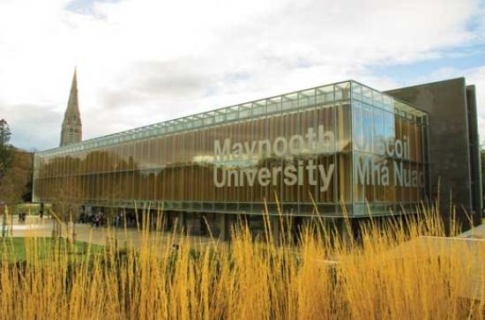
Séamie Ó Néill
B. Ed., B.A., M. Ed., H. Dip in Ed., H. Dip in Ed. Leadership
Head of Education and Director of School Placement,
Froebel Department of Primary and Early Childhood Education, Maynooth University seamie.oneill@mu.ie
Notes:
Primary school teacher; school principal; head of ed in Froebel Dep. School Placement

Slide 3
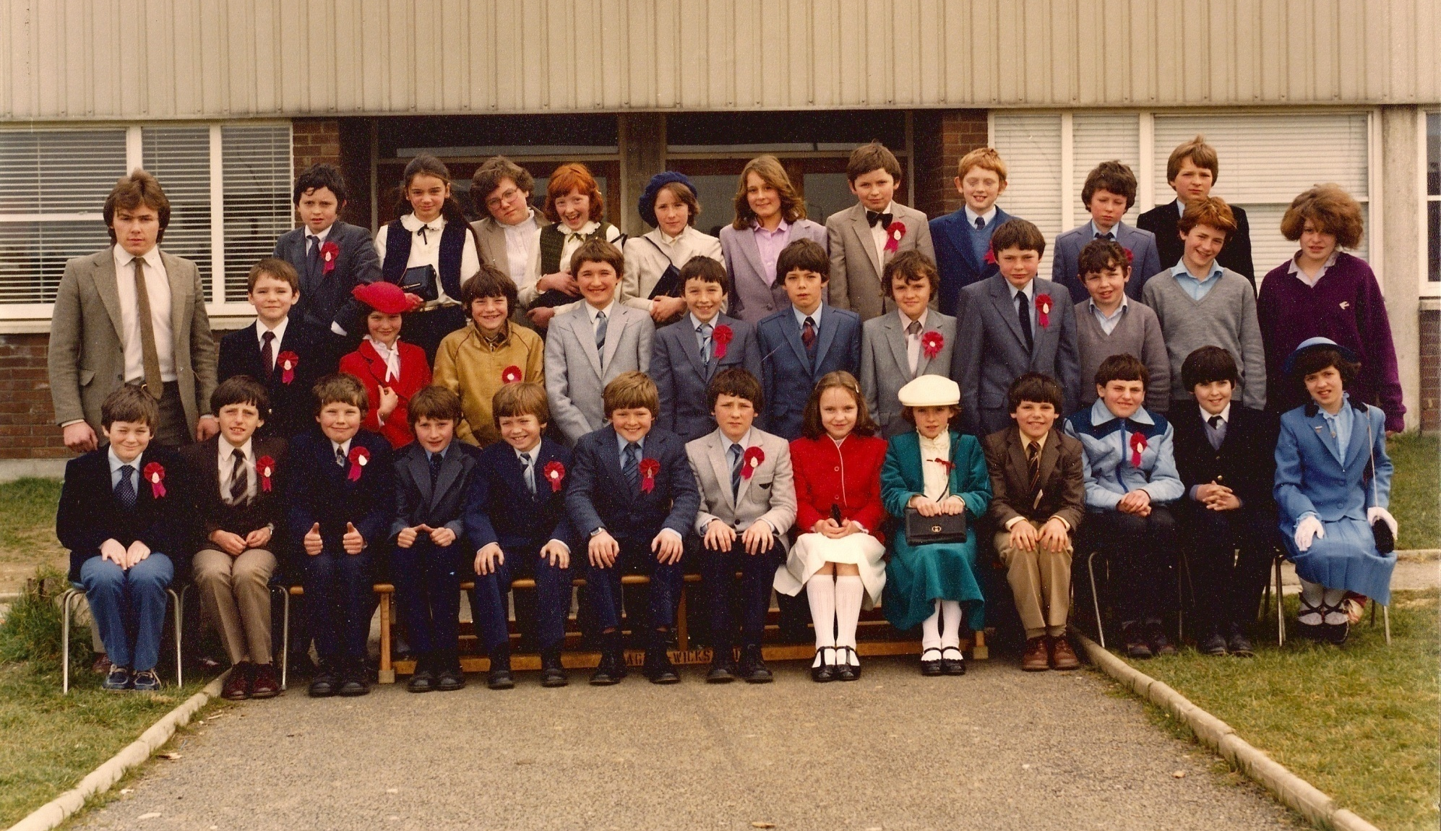
Mo chúlra
Notes:
Primary school teacher; Primary School Principal; Teacher Educator; NCCA; Programme Leader and Developer; Director of School Placement; on 2 boards of management;

Slide 4
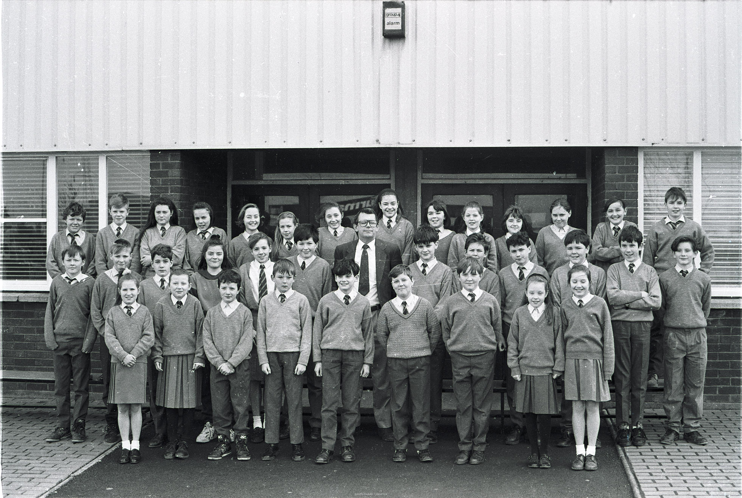
Maurice Curtin Principal of Scoil Treasa Firhouse
1977 to 2007

Slide 5
Focus of this Seminar
This seminar will enable Deputy Principals to examine their role as leaders of curriculum in their schools, through the lens of the concepts of agency and curriculum.

Slide 6
Principal / Deputy Principal

Slide 7
Why did you sign up for this seminar?

Slide 8

My Data Collection Methods!
Director of School Placement: Chatting to teachers and principals
‘No one of us is smarter than all of us’
Notes:
Director of School Placement; not an academic researcher; scholarly practitioner

Slide 9
Section | Topic
1 | Role of Curriculum Leaders in the Current Context
2 | Transformational Change
3 | Agency
4 | Curriculum
5 | Addressing a ‘Wicked Problem’ as a group

Slide 10

Section 1: Current Context
IPPN 2022 Seminar Themes
Financial Support and Guidance
Governance
Reducing your risk
School Accommodation and Capital Programme
Notes:
Comment to Brian O’Doherty that focus of the programme Is more on management that ed issues

Slide 11

From the Boiler House to the Curriculum
Notes:
Principals that I have spoken to admit to preferring talking to the plumber than dealing with curriculum issues

Slide 12

Is running an Irish primary school a job for a principal or CEO?
Dr Geraldine Mooney Simmie is a senior lecturer and Director of EPISTEM, the National Centre for STEM Education in the School of Education at the University of Limerick
https://www.rte.ie/brainstorm/2023/0105/1344861-ireland-primary-school-principals-ceo-management-oecd-eduction/

Slide 13
‘In education policy in Ireland today, the leadership role of the primary school principal is described as little more than the CEO of a business firm. This is rather than a caring and ethical leader tasked with assuring the education and flourishing of the youngest children in society. How did we sleepwalk ourselves into this policy that sees everything in education as little more than a problem of management? How did we get to here so rapidly? And what is at stake for our children and society into the future?

Slide 14
What are the implications for Curriculum Leadership in Schools?

Slide 15
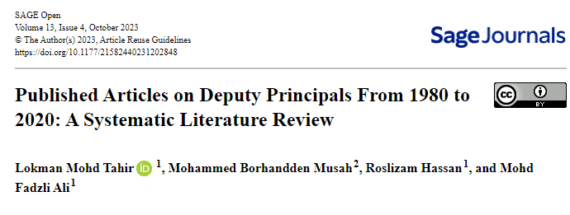

Slide 16
The role of a deputy principal is considered essential to ensure that schools are achieving their objectives (Kwan, 2011; Sharp & Walter, 2012). As a second leadership position, they are responsible for instructional tasks (Glanz, 1994; Oleszewski et al., 2012), supporting and deputizing for principals (Beycioglu et al., 2012; Harvey, 1994a, 1994b) and enhancing teachers’ development (Kwan, 2009). In addition, DPs are also being informally prepared for principalship (Oleszewski et al., 2012). Thus, it is significant to mention that DPs are responsible for school effectiveness. However, there are concerns related to DPs’ roles when DPs’ they were labelled as a “jack of all trades” (Weller & Weller, 2002), unclear on their roles and responsibilities (Armstrong, 2009) and received lack of support (Khumalo et al., 2018)

Slide 17
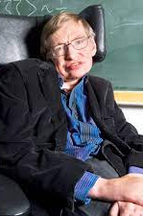

The importance of context
‘I think the next century will be the century of complexity’
- 3rd January 2000

Slide 18
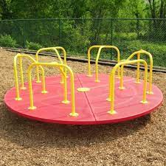
Burnout is a thing!
Teacher Shortage is a thing!
Covid was/ is a thing!
Initiative overload is a thing!
‘…take on more and more work because they are problem solvers and don’t want to appear to be work shy’
Reality is that the merry go round becomes very busy and clogged!

Slide 19


Putting Order on the Chaos

Slide 20

Education Act Part V
22.—(1) The Principal of a recognised school and the teachers in a recognised school, under the direction of the Principal, shall have responsibility, in accordance with this Act, for the instruction provided to students in the school and shall contribute, generally, to the education and personal development of students in that school.

Slide 21
Circular 0044/2019
Domain One: Leading Teaching and Learning
School leaders:
promote a culture of improvement, collaboration, innovation and creativity in learning, teaching and assessment
foster a commitment to inclusion, equality of opportunity and the holistic development of each pupil
manage the planning and implementation of the school curriculum
foster teacher professional development that enriches teachers’ and pupils’ learning

Slide 22

Which ones are you strongest on?
Which one do you shy away from?
2-minute

Slide 23

Section 2 How does Transformational Change happen?

Slide 24
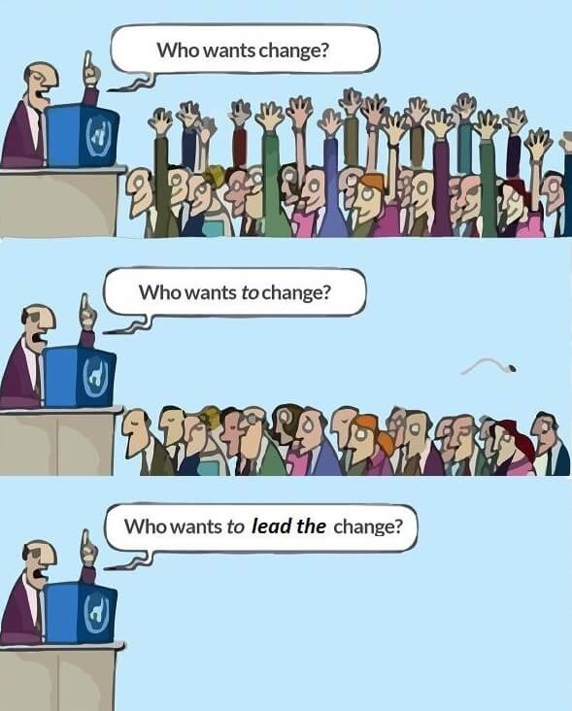
Notes:
Image: https://changeactivation.com/who-wants-to-change/

Slide 25
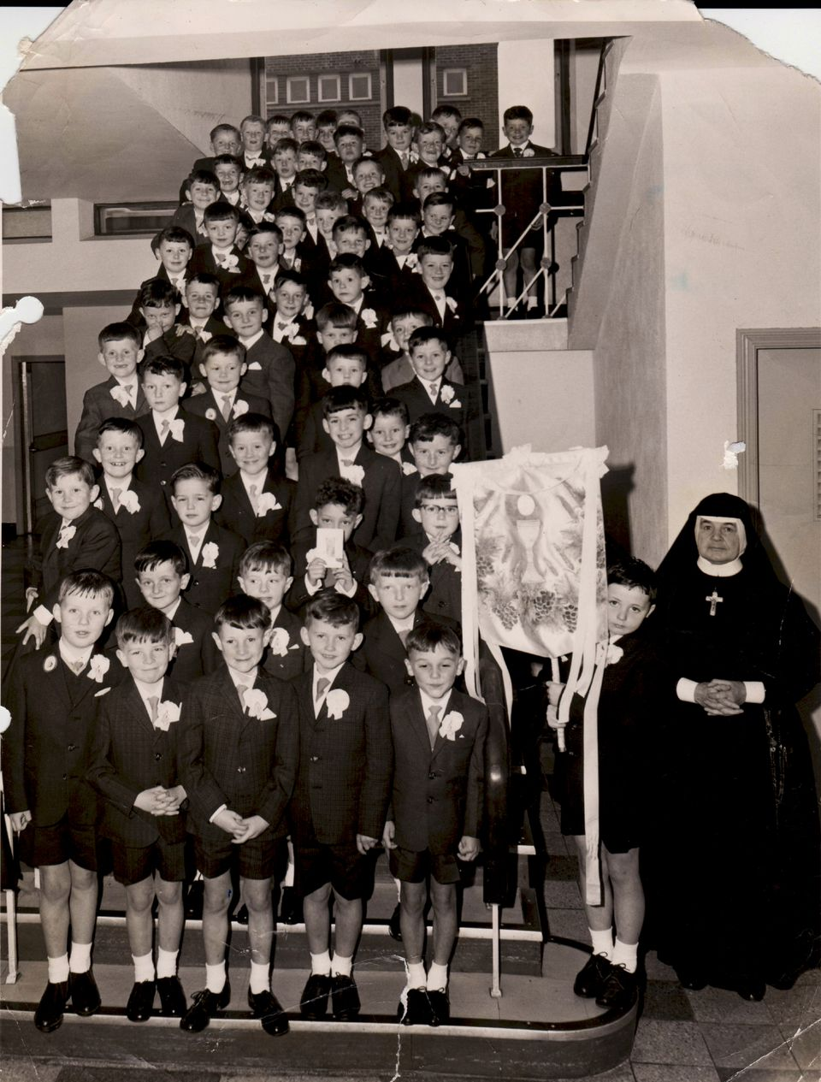
Notes:
Jimmy Murphy Society was harsh
I was reared in a large town in the south of the country
Fear stalked the classrooms and corridors of my primary and post-primary school days like an all-pervasive fog. Violence, both physical and mental, was the norm and accepted as part of the school culture. School was about stratification and so was society, keeping people in their place. Clutching our borrowers’ registration forms, Jimmy Murphy and myself tentatively made our way up the steep steps of the local library to register. The elderly librarian looked at my form and without a word handed me my borrower’s card. She then looked at Jimmy’s form. She noticed the address. As she tore the form in two, she solemnly declared “No-one from that address can borrow here’.

Slide 26
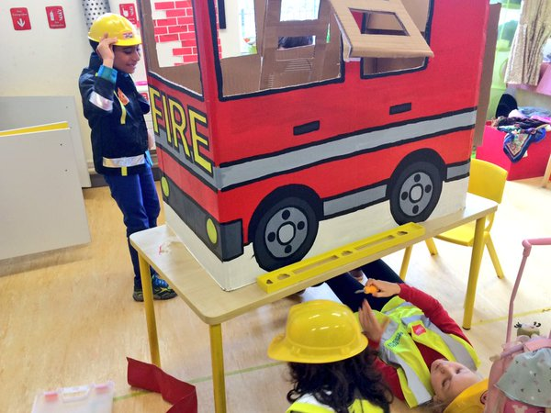

Slide 27
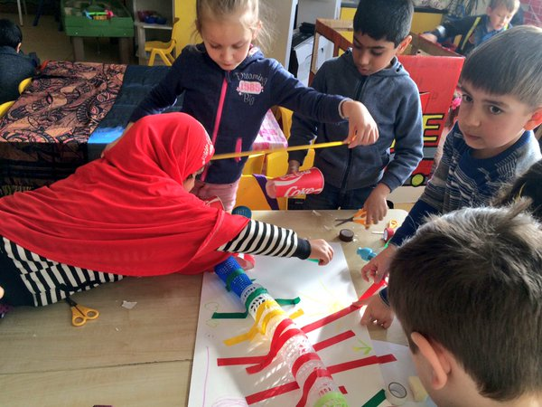

Slide 28
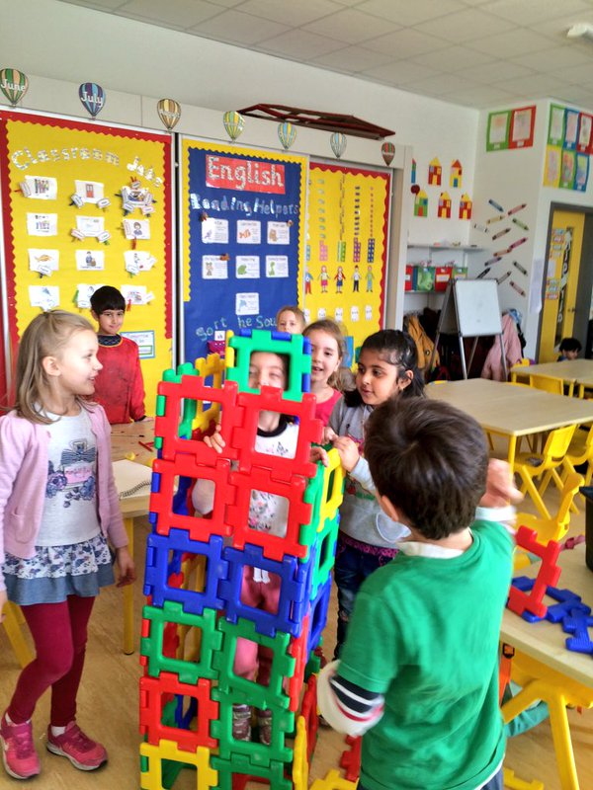

Slide 29
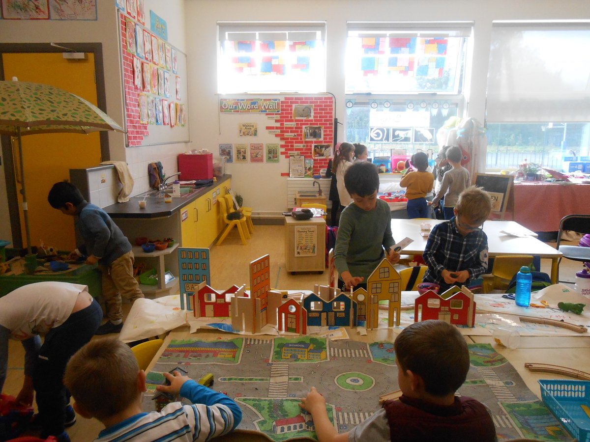

Slide 30
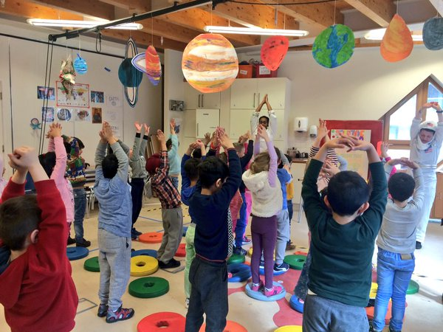

Slide 31
How did that change happen?
2-minute reflection break?

Slide 32

Lens of the 5 P’s
Philosophy
Pedagogy
Partnership
Policy
Politics

Slide 33

A Roadmap for Transformational Change
8 Stage Plan: See Handout

Slide 34

Section 3:
Let’s look at Agency

Slide 35

Teacher Agency
Teacher Agency has emerged as a discrete concept in educational discourse and the policy space, despite challenge of definition
Do we know what it is?
Can we use it to our advantage?

Slide 36
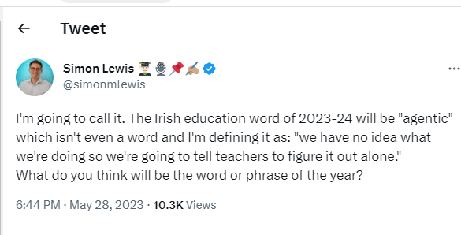

Slide 37
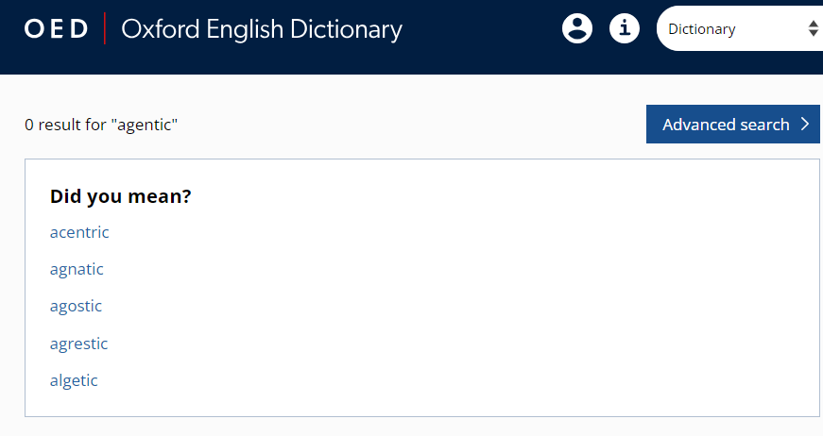

Slide 38
Need to explore what agency is
Agency
Agentic: ‘Is that really a word?”
Agent
Notes:
Agentic
Social cognition theory perspective in which people are producers as well as products of social systems

Slide 39

What is Teacher Agency?
2-minute reflection

Slide 40

What qualities did James Bond possess?

Slide 41

Self-awareness and self-assurance. Bond is very self-aware. ...
Courage to take risks. In the given situations that Bond finds himself in, he has the courage to take risks. ...
James is always impeccable with this word. ...
Measured and calm. ...
Gives and receives great loyalty. ...
Authenticity. ...
A sense of humour
(ach bhí sé tugtha don ól!)

Slide 42

‘ Teachers achieve agency when they are able to choose between different options in any given situation and are able to judge which is most desirable, in the light of the wider purposes of the practice in and through which they act.’
Priestley, M., Biesta, G., and Robinson, S. (2015, p 141). Teacher agency; An Ecological Approach.

Slide 43

Teacher Agency is often linked to Teacher Identity: one’s core beliefs about teaching and being a teacher. These beliefs are very much shaped by one’s experiences

Slide 44

Teacher agency, if it works well, thus has the capacity to make the operation of the educational system, both at the systemic level and the individual and collective level of teacher practice, more intelligent, and therefore more able to engage with the complexities and the uniqueness of the here and now in meaningful and purposeful ways.
(Priestley et al. p 149)

Slide 45

Where does Agency come from
According to Priestley et al (2015) it is not just individual capacity but very much dependant on the context
One could have agency in one setting and not have agency in another
E.g. If you are a teacher working with a Principal who is a firm believer in standardised tests and the opposite
Think of another example…
Notes:
Golf Club v GAA club
Maurice Curtin
Outdoor play v health and safety no running on the yard

Slide 46
According to Orland-Barak (2017, p.247):
‘Teacher agency has become central to our understanding of how teachers assume individual and shared responsibility, generate new ideas, co-ordinate and test them with each other, implement them in their classrooms and engage in social activism through collaborative efforts to improve schools and schooling’.

Slide 47

It is now recognised that there has been a shift to teacher agency in education as it is considered to be an ‘important dimension of teachers’ professionalism’ (Biesta, Priestley and Robinson, 2015, p. 125) and a key factor in the critical engagement of teachers in their work.

Slide 48

A special issue of the educational journal Teachers and Teaching was published in 2015 with a specific focus on teacher professional agency.

Slide 49
Teachers and Teaching (2015)
Theme 1: Pedagogical action as a characteristic of teachers’ professional agency
Theme 2: The relationship between professional identity and teachers’ professional agency
Theme 3: The interweaving of personal capacities and contextual factors in teachers’ professional agency
Notes:
Danielewicz (2001, p.163) defines agency as “the quality of an individual that makes doing possible; it means believing that one’s self is capable of action”.

Slide 50
In the literature
SAGE Handbook of Research on Teacher Education
Section 111
Learning Teacher Agency in Teacher Education
Professional wisdom
Phronesis
Principled improvisation
Responsive teaching
Humanising education
Thoughtfully adaptive Teachers
Disciplined improvisation
Creative
Entrepreneurial
Inspirational
Not just following prescriptive practices

Slide 51

An Agentic professional responds in intelligent, questioning ways to new ideas, complex questions and the changing world we live in

Slide 52
Or do we just react like the goalkeeper -
Where do we get the space for responding in ‘intelligent, questioning ways to new ideas, complex questions and the changing world we live in’

Slide 53

Why is it important?
Seen as a means of working with complexity
Allowing transformational learning
Push back against managerialism
Serves to promote equity and democratic values
Promotes the concept of education as a public good
Activism

Slide 54

Enables response to
Narrow rigid implementation of curriculum
Rigid Policy mandates
Dissonance between personal beliefs and what can be achieved in particular contexts

Slide 55
In contrast to the notion of teachers’ professional agency as a capacity (Pyhältö, Soini, and Pietarinen, 2012; van der Heijden et al., 2015), a characteristic (Vähäsantanen, Saarinen and Eteläpelto, 2009; Oolbekkink-Marchand et al., 2017) or an innate quality that resides within individuals, Priestley, Biesta and Robinson (2013, p.188) propose an alternative view that regards agency as “something that is achieved through engagement with very specific contextual conditions”.

Slide 56
Biesta and Tedder (2007) describe this as an ecological view of agency whereby agency is not regarded as a property or capacity residing in individuals, but as an emergent phenomenon of the ecological conditions through which it is enacted.

Slide 57

An Ecological View of Agency
Interplay of:
Iterational (Past)
Practical Evaluative (Present)
Projective (Future)
(Priestley, Biesta and Robinson, 2015)
Notes:
Framework for understanding teacher agency
Builds on the work of Emirbayer and Mische
How agency is achieved

Slide 58

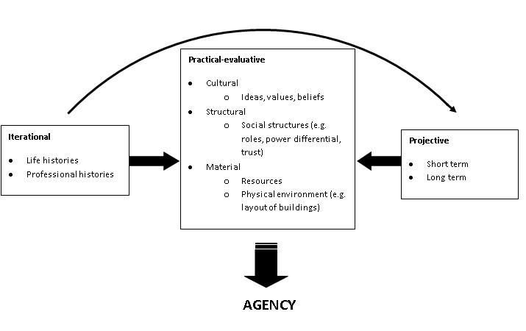
Fig 1.1 An Ecological View of Agency (Priestley, Biesta and Robinson, 2016)

Slide 59

Implications for School Leaders
Create the conditions that shape agency
Ubiquitous 21st century skills:
creativity, critical thinking, problem-solving, collaboration, and digital literacy

Slide 60

As a School Leader,
How can I…?
Develop Agency
Foster Agency
Nurture Agency

Slide 61
Bad and Good Agency
‘Bad’ – e.g. act against policy intentions/act unprofessionally- it can be agentic to be subversive.
Good agency could be exercised to oppose actions/policies that are judged to be damaging to the educational needs of pupils.
‘Put the child at the centre of every decision’
-Loretta Dunphy, Principal, St Gabriel’s Ballyfermot

Slide 62

Working Definition
Professional agency signifies that the teacher operates with professional knowledge, skill, judgment and understanding in professional contexts. It is based on an emerging set of values and dispositions and a developing personal philosophy. It allows teachers to critically reflect on practice in order to act with wisdom in dealing with complexity, and exercise capacity to challenge and change professional practice.

Slide 63

2 -Minute reflection
What are the qualities and features of a school that supports teacher agency?

Slide 64
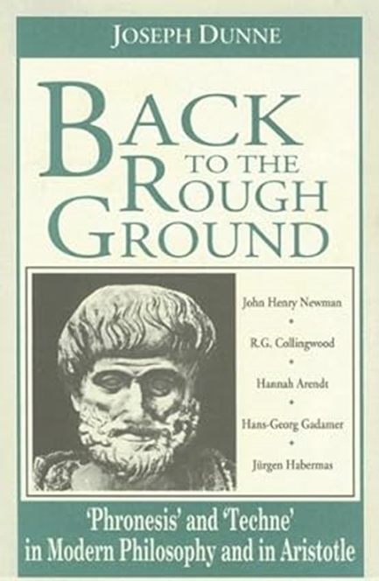
Techne v Phronesis

Slide 65
Section 4: Curriculum

Slide 66
The term curriculum has multiple meanings and definitions, to variously consider aspects of subject content, pedagogy, delivery models, moral and ideological values and assessment
(Kelly, 2009; Priestley, 2019).
Notes:
Kelly, A. V. (2009). The curriculum: theory and practice (6th ed.). London: Sage.
Priestley, M. (2019). Curriculum: concepts and approaches. Retrieved from Curriculum Development: https://mrpriestley.wordpress.com/2019/01/04/curriculum-concepts-and-approaches/

Slide 67

Curriculum Planning
Curriculum planning is fundamentally a political process. In other words, it involves questions of values and is subject to disagreement(Priestley, 2019)
Who decides?
Who adapts?
Who implements?
Notes:
It can be contested / Someone decides
Eg Testing in all classes of the primary school

Slide 68

New Primary Curriculum
Slim
Not prescriptive
Room for Teacher Agency
Could be a challenge for teachers who have a ‘Tell us what to do’ attitude.

Slide 69

Could be a game changer for teachers who really understand their professional role and who approach teaching with creativity, imagination, originality, inventiveness and innovation.

Slide 70
Role of the Deputy Principal in Curriculum Leadership Questions
What is your conceptualisation of that role?
1
Why is that role important?
2
How can professional learning needs be linked to these concepts?
3

Slide 71
Section 5: Addressing a Wicked Problem

Slide 72
The Concepta Conaty (1947 – 2000) Approach
https://www.irishtimes.com/news/concepta-conaty-1.733109

Slide 73

Time Issue
How can you make room / space / time for the role of as Curriculum Leader?
Firstly, do an analysis of your working week
Keep a diary for one week

Slide 74


Slide 75


Slide 76

What curriculum area do you think is of most concern in the primary school today?

Slide 77


Slide 78
What does the Chief Inspector’s Report say about areas of concern?
Search the report for ‘Very concerning’
The word ‘concerning’ is mentioned 13 times and the words
‘Very concerning’ is mentioned once
Can you guess what it might be in relation to?

Slide 79
Pupils’ learning outcomes in Irish in English-medium primary schools remain very concerning

Slide 80

Where do we start?
5 minute chat

Slide 81

A Roadmap for Transformational Change (see handout)
An Agentic professional responds in intelligent, questioning ways to new ideas, complex questions and the changing world we live in

Slide 82

What systemic actions, if any, can be taken to address the issues raised and who is responsible for same?

Slide 83


Slide 84
ESCI research
ESCI Sub Committee on Gaeilge
700 responses
Teacher confidence and competency
CPD Professional Learning not adequate
Resources
Parental Attitudes
Pupil Attidudes

Slide 85
What might YOUr role of as Curriculum Leader look like in addressing that concern?
Why is it important?

Slide 86
Lens of the 5 ps
Philosophy
Pedagogy
Partnership
Policy
Politics

Slide 87
How is the concept of Curriculum Leader and Teacher Agency linked?

Slide 88
‘A leader takes people where they want to go.
A great leader takes people where they don’t necessarily want to go, but ought to be.’
- Rosalyn Carter, writer and activist

Slide 89
What would Maurice Curtin do?

