Slide 1
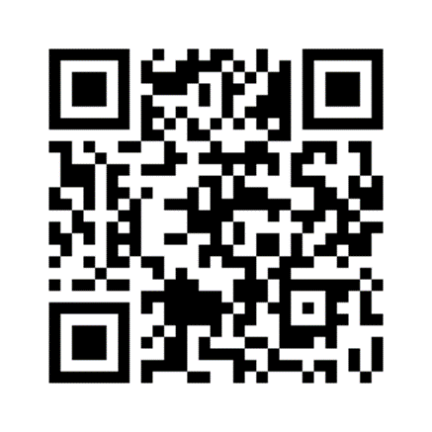
Leading together with Purpose
IPPN Deputy Principals’ Conference, February 8th & 9th 2024,
Galmont Hotel, Galway.
X : @patriciamannixm

Slide 2
Some thoughts on leadership, culture, climate and purpose.
How culture affects our leadership

Slide 3
Purpose

Slide 4
Culture What does the research say?
It is the deeper level of basic assumptions and beliefs that are shared by members of an organisation, that operate unconsciously, and that define in a basic ‘taken-for-granted’ fashion an organisation’s view of itself and it’s environment Schien).
People are the absolute epicentre of culture

Slide 5
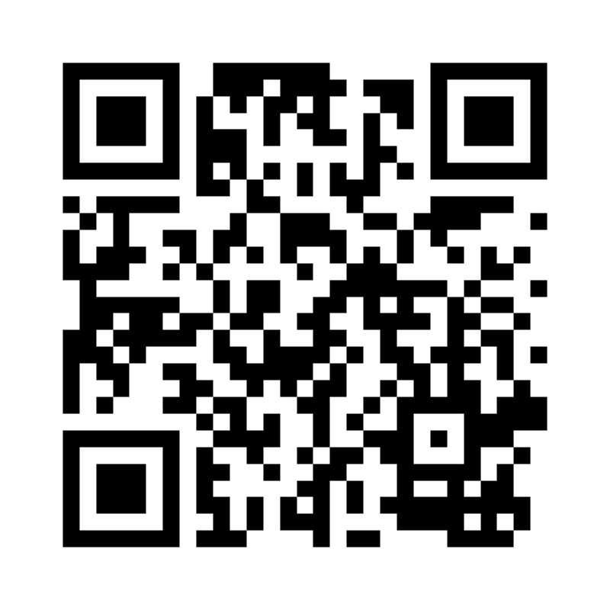
Culture What does the research say?
Culture is situationally unique.
Every school has mindset of school life and its own way of being.
Shared assumptions of who we are.
We create, are given or take on identities.
It is a web of influence that binds us together and creates a unique climate.

Slide 6
We are cultural architects!
This concept has its roots in the work of Edgar Schein leaders are the main architects of culture.
Building a culture that withstands complexity crosses boundaries, and cares for people while pushing for success?
Investing in the building blocks of cultural architecture: core values, language, symbols, and traditions of our work as leaders and communicating consistently and deliberately.
Cultural Architects promote the goals for the organisation (as opposed to what John Stein calls cultural assassins).
We take clear positions for the organisation (we don’t sit on the fence… we don’t tolerate hurling from the ditch).
So, what are the ways that as a leader you can be a cultural architect in your school?

Slide 7
School Culture is Workplace Culture
We dance in the web of connections ever conscious of our boundaries bring the staff with us and not alienate which would bring us into battles that are never easily resolved. Most of us manage, through a dynamic dance between followership and leadership.

Slide 8
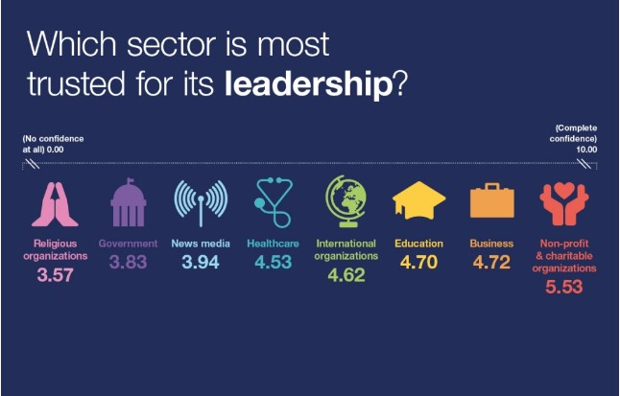
You are in the Right Place Whew!
We are highly trusted still in our field.
Leadership is central to that.
The nature of leadership has radically altered in the past 8 years. Distributive, persuasive, shared, accountable.
We need to embed this in our leadership approaches.
The low levels of deputy principals who are seeking to move into principal roles is distinctly worrying.
Notes:
Quiet Quitting when employees do just the minimum to accomplish the job. According to Gallup, "The ratio of engaged to actively disengaged employees is now 1.8 to 1, the lowest in almost a decade." This means that "quiet quitters" now make up at least 50% of the U.S. workforce.

Slide 9
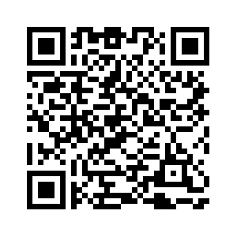
Interesting trends

Slide 11
Distributive Leadership wherefore art thou?
Cultural readiness.
Staff maturity as followers.
Building capacity and freeing our capacity to truly mentor and develop future leaders.
Becoming comfortable in the discomfort of growth conversations i.e. disappointed candidature.

Slide 12
We are expected to adopt a distributive model with colleagues who may look at us askance and think, “isn’t that why you are paid more than me”. (If you are hearing this in your staff room that is a toxic culture flag. Individualistic Culture: Shadow Side).
Those of us who step up to leadership roles with a service agenda (servant leadership) are vulnerable to some systemic exploitation (Collegial Culture Shadow Side).
The Dark Side of Generosity, those with a reputation for giving are selectively targeted for exploitation (Stanley et al 2023).
What about followership? There sometimes appears a power imbalance when one drills more deeply into the fragmented nature of some school cultures…

Slide 13
The published texts on school & organisational culture completely ignore the dynamic with staff but successful leaders are very clued into it.
Seen as passive recipients of leadership (Cruickshank 2017) when the absolute opposite is the case.
We assume everyone knows how to follow without ever discussing it. Some cultures of followship are productive, others not, but have become embedded.
What makes staff follow one leader and not another (disposition of the leader, micropolitics, disenchantment, unsuccessful candidature, loyalty, kindness, explicit articulation of expectation).
If we pivot this should we make explicit that followers also need to be responsible….
So much focus on leadership skills, so much emotional labour when a substantive part of the leadership dynamic is not being engaged i.e. responsible followership for healthy work culture.

Slide 14
(i) Leader-centric view
Leaders hold all power and directly influence followers to achieve objectives. Followers as passive bystanders who ‘follow’ and ‘receive’ leadership influence and respond wilfully without much resistance or challenge.
(ii) Follower-centric approach
Focuses on the role of the follower in the creation of leaders and leadership. Leadership is viewed as socially constructed by followers who create narratives around their leaders, dependent on what they need them ‘to be’.
(iii) Relational approach
Relational dynamics are key; through leader-member exchanges and how leaders and followers collaborate to produce quality work and organisational outcomes.

Slide 15
What do we mean by Emotionally Intelligent organisational culture
“Emotionally Intelligent organisational culture places the person at the heart of our practice. Well-being, growth, and development of individuals is at the core of decision-making and organisational strategies. Needs, aspirations, and concerns of team members are a priority because a thriving school is built upon recognizing that a successful organization is built upon a foundation of empowered and engaged individuals” (Mannix McNamara 2023).
This includes leaders too!!
It is also characterised by courageous leadership and courageous followership…dignity and respect, responsibility taking.

Slide 16
Emotionally Intelligent School Culture
Four domains: self-awareness, self-management, social awareness, and relationship management.
Self-Leadership… aware of our own emotional makeup, being aware of what I say and do that might be contributing to poorer culture (self-management), sensitive and inspiring to others, and able to deal with day-to-day problems as we work on more fundamental changes in the culture of the organization.
How do I intuitively communicate my leadership to others?
If they were to use one word to describe my leadership me what would it be?
How does my principal see me? Do I need to chat the narrative?
How does the staff see me? Do I need to chat the narrative?

Slide 17
What do we mean by Emotionally Intelligent organisational culture
Empathy: A deep understanding and capacity to relate to the emotions, perspectives, and challenges of self and staff and to expect it in return.
Listening: To seek to really understand the needs and experiences of the self and the other.
Trusting: Our own current best thinking, & helping staff become able to let go of being right.
Psychological Safety: Separate & Connected (See Dr. Tony Humphries latest book on this). We are held to higher standard as leaders, but we also need to be courageous and hold staff to the same.
Feedback: Remember we are giving feedback with our whole being. Not giving genuine feedback = group think in a very short time. Where do we get feedback that is not our echo chamber?
Servant Leadership, the needs of others take precedence, if we all took care of the other then all are taken care of.
“Emotionally Intelligent organisational culture places the person at the heart of our practice. Well-being, growth, and development of individuals is at the core of decision-making and organisational strategies. Needs, aspirations, and concerns of team members are a priority because a thriving school is built upon recognizing that a successful organization is built upon a foundation of empowered and engaged individuals” (Mannix McNamara 2023).
This includes leaders too!!
It is also characterised by courageous leadership and courageous followership…dignity and respect, responsibility taking.

Slide 18
Culture is not static (even when it feels stuck). Organic shaped by people.
It is constantly changing and adapting (meaning it can be shaped).
Each school has different cultures or micro-cultures within the staff. A continuum of learning communities (at best) or cliques (at worst).
We change culture by our behaviours.
How do we continue to work with angry or disenchanted staff. If left undealt with, they damage culture.
How do conversations about leadership, ambition, succession planning happen in transparent and holistic ways?
Plan for how a culture of being comfortable with feedback becomes embedded in staff?

