Slide 1

The Principal and Deputy Principal
A Partnership in Trust
Áine Fitzpatrick, Deputy Principal
Enda McGorman, Principal
Mary, Mother of Hope Senior National School

Slide 2
Introductions
Áine Fitzpatrick, Deputy Principal
Enda McGorman, Principal

Slide 3

The Principal and Deputy Principal:
A partnership in trust
Activity:
What would I like to learn from today’s seminar?

Slide 4
Our School Context
E
Mary Mother of Hope Senior National School:
Enda McGorman Principal
Áine Fitzpatrick Deputy Principal
16 classes
461 pupils
24 teaching staff
4 SNAs

Slide 5
But it wasn’t always like this!
E
Mary Mother of Hope Senior National School: the early days.
Start up School
Started with precious little!
Importance of developing good relationships
The critical relationship is the Principal / Deputy Principal
Notes:
In 2001, we opened as a start-up school, I was a teaching principal with 55 pupils
We had 2 JI teachers- one experienced and one NQT and this was a mix that was imp to me- a blend of newly qualified and experienced teachers
Picture the three of us- no secretary, no caretaker, three weeks to opening, no building
Children arriving, literally on a daily basis; including these exotic children that we called newcomers!
We literally had to build everything from the ground up
I didn’t need to be told of the importance of developing a culture that was inclusive, democratic, that encouraged people taking shared responsibility for decision making- it wasn’t a luxury, for us it was essential for our survival! And central to this was the importance of building relationships- if there is one thing, one message that we would like to emphasise in this workshop is the central importance of building relationships: with all our stakeholders in the school
But in that spirit of openness and collegiality, there was also great possibility for creativity and development
And of course the most important relationship was that which I developed with my Deputy.
From the outset, I was very clear that this was a shared journey, that the development of our school would be one which we would foster together, that we would work in a spirit of partnerhsip, that we would be open to listenting, advising and indeed, critiquing each other’s thinking- but that at the centre of all of this endeavour was the pupils in our care and the school that we wished to grow.
And how did we do that? Lots of talking, lots of conversations, making time for conversations, sitting in each others classrooms after school, correcting copies and talking,
And the bigger the school got, the more difficult it wass and the more important it was that we made time for these conversations.
And so our school continued to grow, to the point in 2007, when we had not three classes but 26; not 55 children but 780.
And this is what our staff of three had turned into

Slide 6
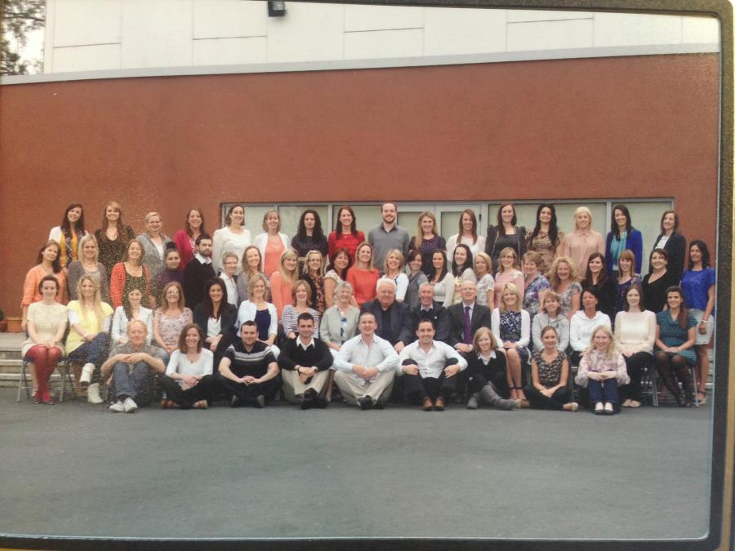
Deputy Principal: An Evolving Role
Notes:
Talk about how big and how quickly we grew
How we had to take the painful decision to spliy
My DP took on the role in the JS
I remaine din the Senior Schol
And that’s when Aine joined the team as Dp in the SNS
Take voer Aine

Slide 7
The Early Days
Beginnings
- Staff Member to Deputy Principal
- Mixed Emotions ‘Big shoes to fill’
-Collegial Support
An aspiring leader
‘Deputy Principals must be empowered to lead but they also in their turn must want to lead.’
Ciaran McMahon , Developing the role of Deputy Principal, Leadership Plus March 2016
Notes:
Previous school- no promotion opportunities, youngest member for staff! Did get opportunities to lead. Encourages and supported by the principal. Came to MMH in 2005 and relatively quickly. Special Duties teacher- responsibilities
Choose to go to senior school- offer Experience
Opportunity arose to go for the Deputy principal. New developing school lots of opportunities to pursue vision for the school. V fortunate to be appointed.
Delighted and excited looking forward to challenge of leadership and the job.
Appointment did come with mixed emotions. New member of staff, very happy and very comfortable colleagues and friends on staff. Concerned about change in relationships. How would people perceive me? Would relationships change?
Big worry – big shoes to fill. Previous deputy principal, very firmly established in our school, as deputy, a very progressive, supportive and professional deputy? How could I do what she what done? Would staff be saying –oh she’s not the old DP., its not same!
Didn’t have to worry. Staff very supportive and affirmative in that first year of learning and continue too be so. `I have learned like many of us who have taken over deputy principal ships that we don’t have any big shoes to fill. We are aspiring leaders, we may have different styles and personalities
but given the opportunities we want to lead.
CIARAN MCMAHON PRINCIPAL OF SCOIL BHRIDE BOYS NS, KILCRUTTIN, TULLAMORE, CO. OFFALY

Slide 8
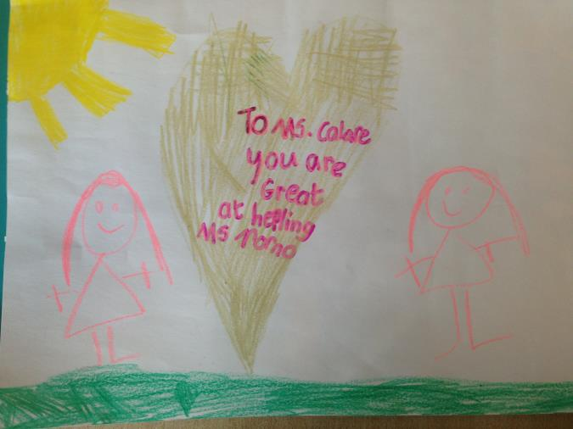
Deputy Principal: from the mouth of babes!

Slide 9
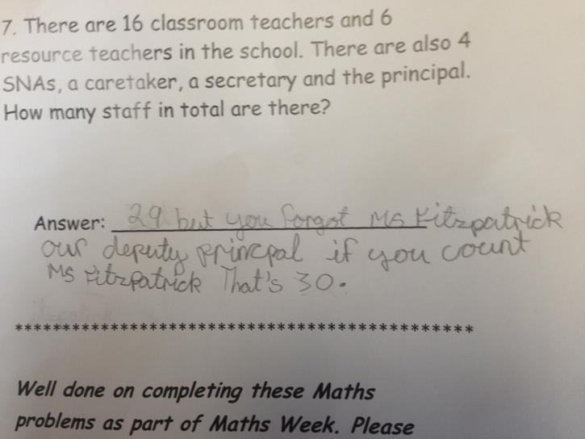
Deputy Principal: An Evolving Role
Notes:
Nirviti sees the deputy as aleader- co leader in the chool
we are not just there to ‘help’ and ‘assist’ the principal
School are v different places to the circualr on deputy principals in 1972
or indeed the circular on posts of responsibility
Schools in 2016 are very busy and demanfding places- like small businesses-one person cannot do everything
If I had a ‘euro’ Go and apply for an principalship I would be a very rich teacher
Centenary commemorations for 1916 and asking the children of 2016 to look forward
This is the stimulus for me coming here to day and proclaiming leadership- and that’s exactly what we both ant to do- to Proclaim leadership
You forgot the deputy- how could you forget the other leader in the school

Slide 10
A Partnership In Trust: what do we mean?
E
What do we mean by a Partnership in Trust?
What is the foundation of that trust?
How do we understand leadership ?
Notes:
These are some of the questions we want to surface in the remaining of our workshop:
What have we learned together from our experience of leading in MMOH?
We have some thoughts on this which we would like to share with you

Slide 11
Shared Understanding of the
Principal / Deputy Principal Relationship
E
A focus on building and maintaining relationships (the 3Rs!)
There is trust
Shared values
Shared vision
Continually asking questions
That there is openness to different views / opinions
That we can make mistakes
Notes:
Enda

Slide 12
The how of leading:
E
Delegation of Deputy Principal duties:
Clear and defined duties and responsibilities
Real Leadership opportunities
Balance between Management duties and Leading learning
Pastoral Care
Notes:
The BoM’s role in defining the duties:
These are the elements that I see as important for each of us as DPs in developing our role.

Slide 13
Important elements of leading:
As a co-leader
As a leader of learning
As a support to others
Developing leadership in others
Notes:
In theory, this is how we understand leading as a deputy principal
These are the elements that we should see as important for each of us as DPs in developing our role.

Slide 14
The how of leading
* As a co-leader
School Community see and value co-leadership as the norm
Confidence and assurance to manage and decide
Sharing leadership opportunities
Sharing the day to day management within the school
Notes:
This is what it looks like in practice
The school community see partnership in operation. Co leadership and co-roles are the norm. We know that this does not happen overnight. We need to work at this and share opportunities. This can begin in sharing responsibilities and the co facilitation at staff /parent meetings, celebrations, staff occasions. Enda and Aine – Not just Enda- reference; induction meetings with 3rd class, shared responsibilities- at staff meetings, ‘celebratory days in the school. Staff nights out
Grows and develops with time. First day ‘acting up’ second day acting up third day- I’ve to make an important decision.
Shared vision shared focus- in all our our school contexts-this is why we do what we do.
Teacher went home sick – I told him to go home, arranged supervision.
Staff come with a query, knowing that we have the confidence to say that’s ok, you do ahead with that. Tina- talks next week.
Sharing leadership opportunities. When deciding priorities for the year- I’ll go that committee, you go the other. Knowing that it’s not possible to for one person to do it all. SSE. We all know our strengths & limitations ‘IT” committee.
OLCS, School Enrolment
Critical Incidents

Slide 15
The how of leading
* As a co-leader
Decision making in partnership
Professional Dialogue and Reflection
Sharing responsibility and accountability
Flexibility
Notes:
This is what it looks like in practice
Decision making in partnership- those difficult decisions, decision about what needs to be prioritised- so many decisions to make daily in schools. So important to share those decisions. Social media
Solution focused, being the devils advocate, trashing things out. We all know that they are the decisions you can stand over be accountable for rand ‘aren’t ’t we so glad we did it that way?’
Disagreeing robust conversations. Being able to disagree. Take time to build up that trust and confidence in each other. Makes for very professional conversations. Staff perceptions!!!
Disagreement- changing a pupils SNA last year
Flexibility- decision making process, change of direction in policy, not everything will go as planned.

Slide 16
‘The how of leading’
*as a leader of learning
opportunities to lead
empowering others
improving teaching and learning
the child at the center of what we do
Notes:
As a deputy principal we are in a unique position in that, almost all of us, have a teaching role ourselves.
We are close to the learning, and if our Principal is admin, we are closest to pupil learning
That give us credibility and proximity to the learning of each pupil;
Enables us to model the new learning / methodologies / ideas that we want to develop with our staff.
We lead learning in our practice, in our classes, at our class levels, in the advice and support in we give in “walking the talk and in the opportunities we take in leading curriculum development.
But also in empowering others: In affirming, harnessing the talents and capabilities of others, in supporting and guiding. In encouraging colleagues to share best practice with other colleagues-I have an idea.-do think this might be something worth pursing. With with our support watching the initiative grow and flourish

Slide 17
Ways in which I lead learning in our school
Interculturalism
Team Teaching
Friends for Life
‘Building Bridges of Understanding’ Dr Martin Gleeson
Notes:
Took Out PE .

Slide 18
The Deputy Principal leading learning
Initiate,
research,
inform,
motivate ,
pilot,
support and appraise,
evaluate,
review,
empower,
embed,
Thank! (with scones!!)
Notes:
How do we do that?
How can we as deputies lead learning in our schools

Slide 19
The how of leading
* as a support to others
Sense of responsibility for the school community
‘Open Door’ policy
listener, a communicator and advisor
Notes:
Role of the DP as a ‘buffer’
People may not always want to bring things to the attention of the P. This comes only if there is trust-
a priviledged role- a confidante, offer support and gudance to all members of the school community.
This can be through presonal/professional difficulities
Sounding board- issues with children/parents in class. “Monkeys” learnt over the years to faciiliate to listen, what are the issues and what do you think you can do. Wonderful to watch staff at meetings arrive at solutions but offering that facility to chat-professional conversations.
Very rewardinfg
We as teachers invest so much of ourselves in our profession and in the people we work with, the children and the school community. We all know in our schools as deputies and as teachers how invaluable support and understanding from the deputy and the principal is.

Slide 20
The how of leading:
* Developing leadership in others
Senior and Middle Management Structures
Empowering Staff to lead
Continuous Professional Development
Teachers as teacher educators
Notes:
Early days- back to what Enda said
Structures in place in school
MMM, SMM, currucular committees,
green schools, active schools IT Green Schools Flags, Active Schools Flag, IT School’s of Distinction- School Facilitated Leadership for these/
Giving people opportunities.
See leadership opportunities in those who might not yet see it in themselves! Approach and include
Offer and encpurage Staff - courses SESS, Dublin West
Staff completing further study How can we help?
We encourage and celebrate the learning of others

Slide 21

Trust

Slide 22
‘The how of leading’
- Developing the Management role
E
Clearly defined role:
Defined duties
Real and meaningful responsibilities
Trust and Accountability
Confidence to do the job!
Notes:
Comes with time
Needs to be practiced
Need support
Trust and accountability develop and grow out of each other with time and with experience

Slide 23

The Management Aspect of My Role
Special Education Needs Coordinator
Management of Special Needs Assistants
Transfer Of Information
Intercultural Coordinator
School Medical File
Behaviour Management
‘Planning” Co-ordinator
Pastoral care: Staff, students , parents
Notes:
Duties Page

Slide 24

Time!
Scarcity of resources- the most precious resource is Time:
Need to be scrupulous in how we use it!
Need to be smart in the use of our time
Do we ever ask what should be stop doing?

Slide 25


GUILT!!!!
Notes:
We take small steps. We teach and we lead. We take the opportunties to lead that we can, we priorities and we say no!

Slide 26
A few anecdotes
Proclamation day – Wrestle for 1916
Snake in the yard
Cat living in Computer room
Korean Principals visit

Slide 27
Just a thought!
E
“To lead school communities, we need . . . .
. . . leadership for meaning,
. . . leadership for problem solving,
. . . collegial leadership,
. . . leadership as shared responsibility,
. . . leadership that serves school purposes,
. . . leadership that is tough enough to
demand a great deal from everyone,
. . . and leadership that is tender enough
to encourage the heart"
(Sergiovanni,1996)

Slide 28
Proclaiming Leadership
Deputy Principal as a leader
An evolving role
A role to be defined by you in your school context
No ‘right” way to proclaiming Leadership
Children are at the center of why we do what we do

Slide 29
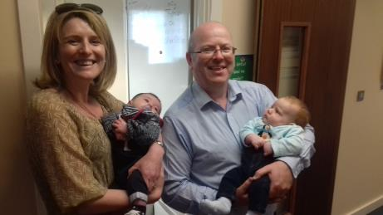
Life!
‘We have talked, debated, argued, worried, cried and laughed through many school days but are always thankful for the privilege of being part of a wonderful community of children, staff, and parents’

Slide 30
So where from here?
Breath!
Start where you are!
Use what you have!
Do what you can!

Slide 31

Proclaiming Leadership

Slide 32

Questions

