Slide 1
Conflict
Managing Adult Relationships
Angela Lynch
Deputy Principals’ Conference 2016

Slide 2
Overview
Societal issues
Relational world
Communication
Innate gift
Developing proficiency
Knowing yourself, knowing others
Leader centric culture

Slide 3
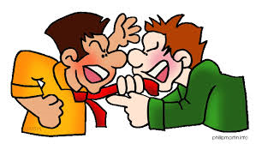
Conflict in the School Community
Staff Members
Staff Members and Principal
School and Parents
Principal and Chairperson/Board

Slide 4
‘If we don’t change the direction we are going, then we are likely to end up where we are heading.’
Chinese Proverb

Slide 5
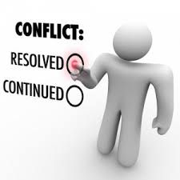
Conflict is Inevitable
Part of life experience
Non engagement with conflict
Making the shift
Learning skills
Molehills and mountains

Slide 6
Procedures
Parental Complaints Procedure
Steps of procedure
Communication to all parties
Roles and responsibilities
Grievance Procedure for Staff

Slide 7
Parental Complaints Procedure
If we know that procedures exist and insist that we use them, why then is conflict especially in the area of parent / school relations escalating at an alarming rate?

Slide 8
What do people need when they make a complaint?
To be listened to
To be understood
To have their feelings of hurt, anger or frustration acknowledged
To have the complaint taken seriously
To have the complaint dealt with as a matter of urgency (Putting it on the long finger tends to escalate the problem)
Above all else, to be treated with respect

Slide 9
Parents
Parent has rehearsed
Parent is anxious
Parent is defensive
Parent naturally believes their child
Parent may have their own agendas
Parent’s emotions are high

Slide 10
Self awareness
What are you feeling?
What are you thinking?

Slide 11
Considerations
Be calm
Listening intention
Safe atmosphere
Taking notes
Eye contact
Ask questions (not an inquisition!)
Sum up and reflect issue to person
Next step and timescale

Slide 12
Walking through the procedure
Origin of complaint
Class teacher
Principal
Chairperson
Board of Management
Patron
Escalated stages

Slide 13
Communication & Discussion
Necessity of clear communication and discussion to:
  Produce a plan, the key elements of which define what situations constitute conflict
  Indicate steps for handling conflict when it arises
  Examine beliefs about conflict
  Plan how this will be communicated and to whom

Slide 14
Teacher/Principal/Chairperson
Acknowledge presence of parent
Listen
Taking notes
Mutual concern and support
Remain calm
Show hope – working together
Child at centre of issue

Slide 15
‘Courage is what it takes to stand up and speak. Courage is also what it takes to sit down and listen.’
Winston Churchill

Slide 16
‘It is astonishing that elements which seem insolvable become solvable when someone listens. How confusions which seem irremediable turn into clear flowing streams when one is heard.’
Carl Rogers

Slide 17

Research
7% - Word meanings
38% - Tone of voice
55% - Body Language

Slide 18
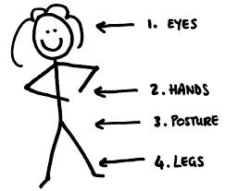
Body Language
Awareness of own body language
Awareness of the other person’s body language

Slide 19
Working with Staff
Agreement in advance re scenarios
Rehearsing the “What if___” scenarios
Type of language
Becoming aware of emotions
Becoming aware of one’s own triggers
Always refer to national procedures
Seek advice in advance

Slide 20
‘The most important thing in communication is hearing what isn’t being said. The art of reading between the lines is a life long quest of the wise.’
Shannon L. Adler

