Slide 1

Emotional Wellbeing – making it the heart of the school community
Maria Doyle & Hilary Mc Carthy
IPPN Deputy Principals Conference
May 2016

Slide 2

What is Wellbeing?
A state of being Comfortable, Healthy & Happy

Slide 3
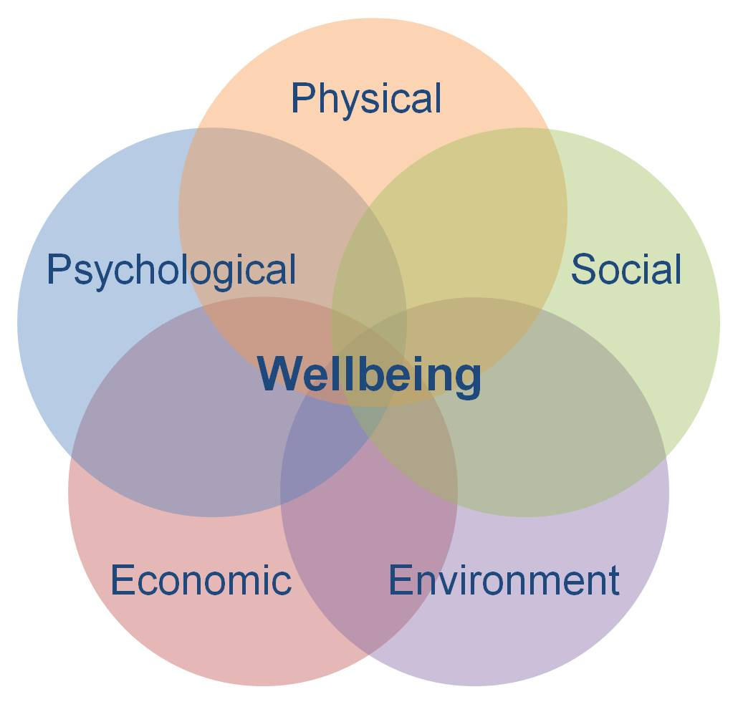
Influencing factors on Wellbeing

Slide 4
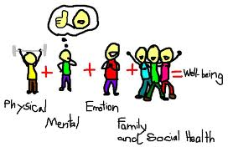
The Wellbeing Equation!

Slide 5
Why are we discussing Wellbeing in Schools?
Evidence from IPPN surveys
National Symposium & establishment of WTL
National awareness campaigns
Frustration with lack of supports for pupils displaying symptoms of emotional stress, anxiety and mental health issues
The need for more sustainable and accessible support system for pupils most at risk
Acceptance that Wellbeing is critical to learning

Slide 6
What does a developing Culture of Wellbeing mean?
Looking at what we currently do in our schools to promote respect, compassion, kindness & fairness
Developing and sustaining relationships and connections
Examining how behaviours affect us and others
Acknowledging our own vulnerabilities as adults around Emotional Wellbeing
Embedding Emotional Wellbeing in everything that a school does

Slide 7

What do we NOT need to do
Re invent the wheel!
Act as psychologists/ mental health experts
Get involved with yet another initiative
Believe that the school MUST solve the problem
Add to the workload

Slide 8

Resources currently available
Well Being in Schools Guidelines
SPHE Programme
Stay Safe Programme
NEPS Continuum of Support
On line supports
School based supports

Slide 9
Facts
When a child feels they belong they are more likely to perform better in school
Children will remember little about what you taught them, BUT they will always remember the way you treated them
We as adults need to build our own resilience and keep ourselves emotionally strong

Slide 10
Soul Search
Is the culture in your school providing a safe space for Emotional Wellbeing of pupils to be nurtured?
Is the staff in your school open to development of their own Emotional Resilience
What are you currently doing well in your school to promote pupil Wellbeing ?
What are you currently doing well in your school to promote staff Wellbeing?

Slide 11

How can you build our own personal Resilience?
Maintain flexibility & balance in our lives
Allow ourselves to experience strong emotions
Spend time with friends and loved ones
Rely on others
Rely on yourself

Slide 12
Some school based activities/strategies
Student Council/Active School Committee
Monthly Assembly: Celebrate individual and whole school achievements
Accentuating the Positive – End of Year Booklet (Collaborative Project - pupil/staff)
Restorative Practice
Classroom Worry Box
Celebration noticeboard at school reception

Slide 13

What is doable
Look at the culture of your school and begin/ continue the Wellbeing conversation
Look at your own wellbeing . You cannot give to children what you do not have yourself
Use SSE as a tool to promote the Wellbeing agenda
Promote a culture of Wellbeing

Slide 14
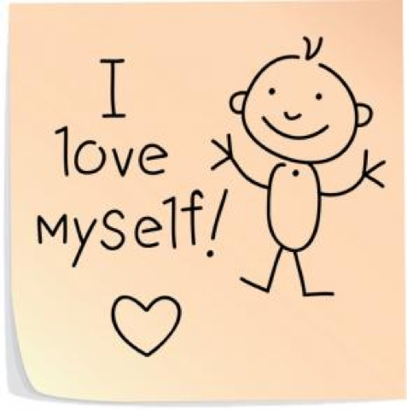
Begin with the self and then reach out
You can make a difference!

