Slide 1
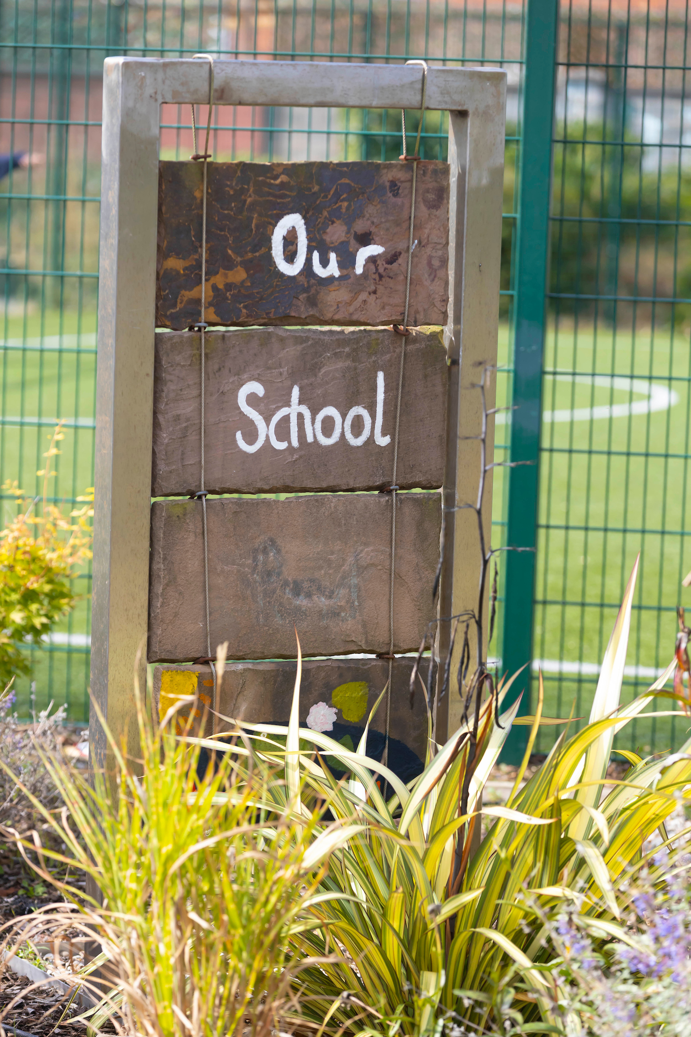
Fostering a Whole-of-School Culture of Well-being
Enda McGorman
Principal of MMOH Senior National School since 2001.
Currently Seconded to the CPSMA.
Delighted to share practical strategies for staff well-being.

Slide 2
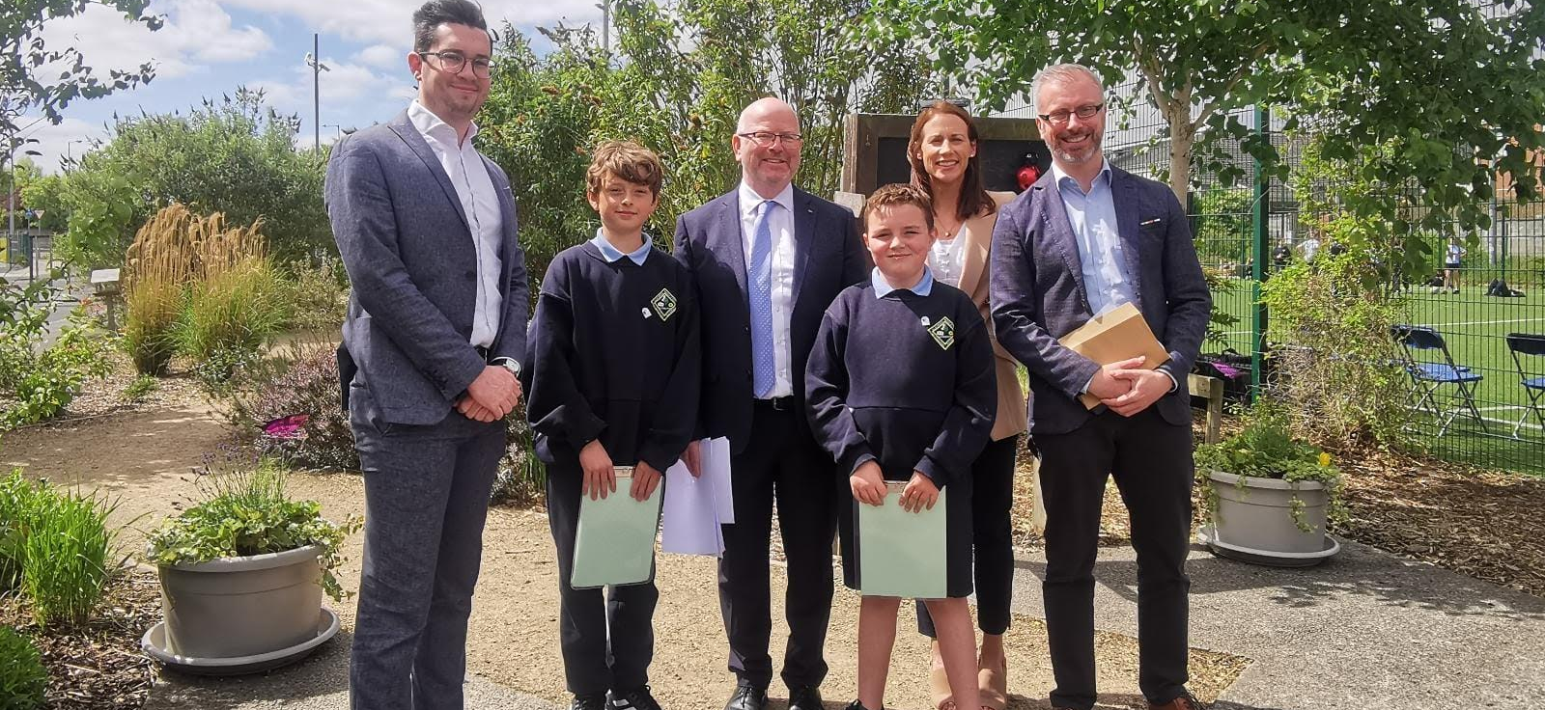
Presentation Overview
School leader's pivotal role in staff well-being.
Key areas of emphasis:
- Impactful leadership
- Essential leadership
- Opportunities for others to lead
Diverse strategies

Slide 3
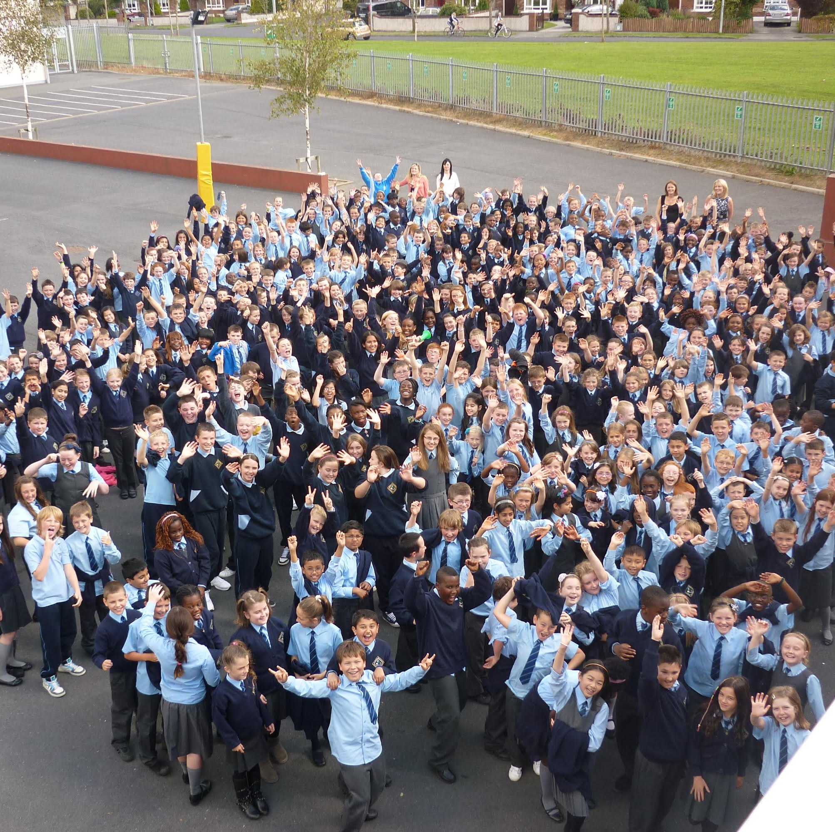
Starting Point: Wellness Awareness
Starting the school year by addressing wellness.
Signposts!

Slide 4
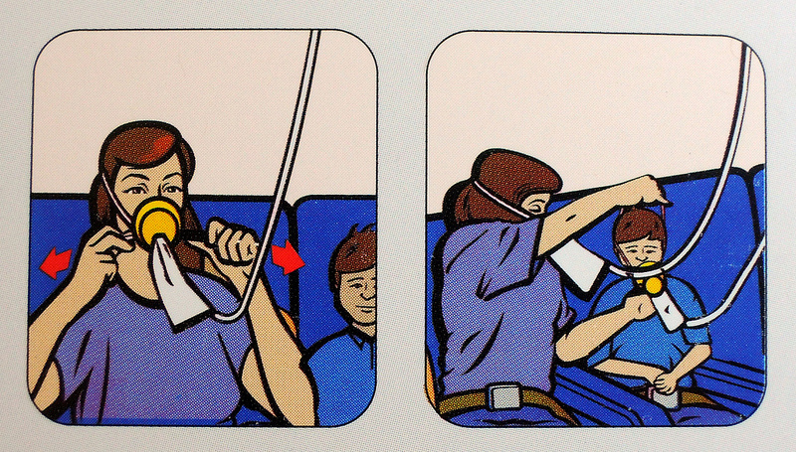
Emphasizing Self-Care
Analogy: Put on your mask first before assisting others.
Self-care is essential role in effective leadership.
Prioritizing self-care for effective leadership in all school aspects.

Slide 5
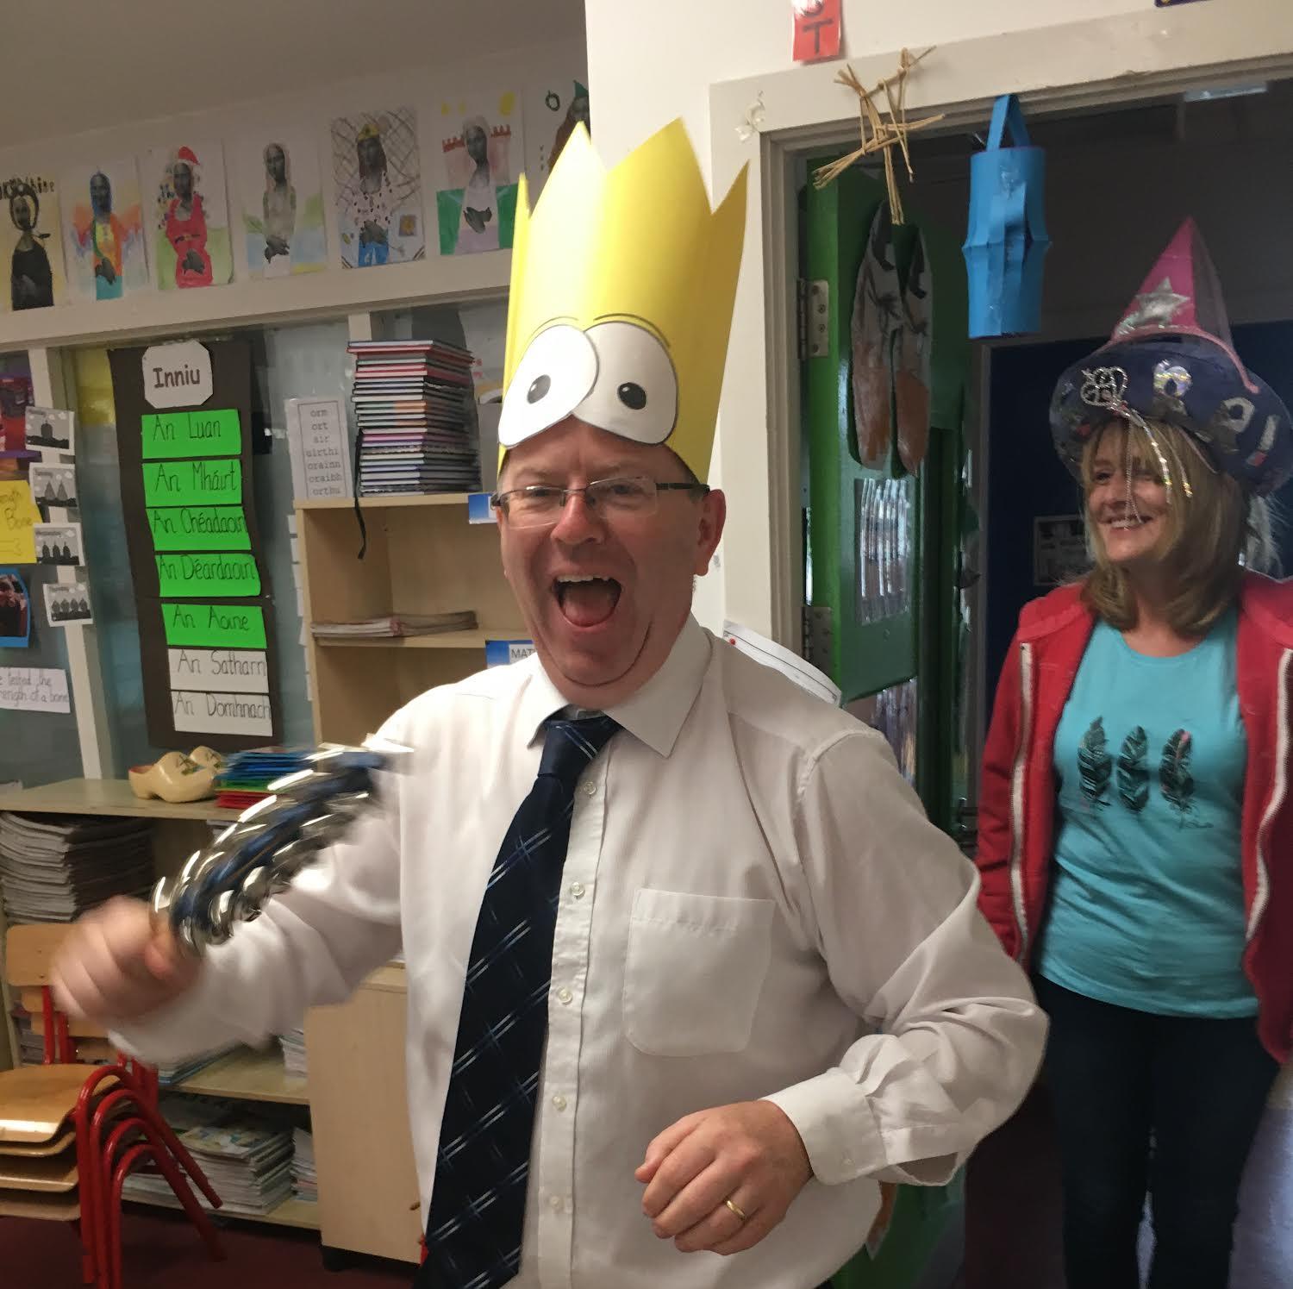
The Power of Modeling
Leaders as Creators of Culture.
An emphasis on school culture for well-being.
Building relationships as the 3Rs of leadership.
Practical tips for fostering relationships based on experience.

Slide 6
The Power of Modeling
Leaders as Creators of Culture.
An emphasis on school culture for well-being.
Building relationships as the 3Rs of leadership.
Practical tips for fostering relationships based on experience.

Slide 7
Leading Through Grief and Trauma
Challenges of leading during difficult times.
The leader's unique role during grief and trauma.
The importance of processing feelings for staff and students.

Slide 8
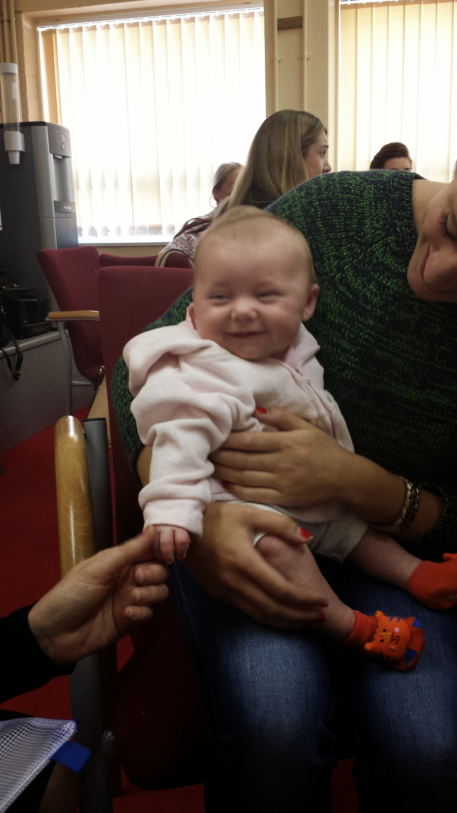
Well-Being as a Whole School Endeavor
The social committee's role in fostering well-being through events.
The evolution towards a systematic approach to staff well-being.
The formation and impact of the Well-Being committee.
A 360 -degree perspective on well-being.

Slide 9
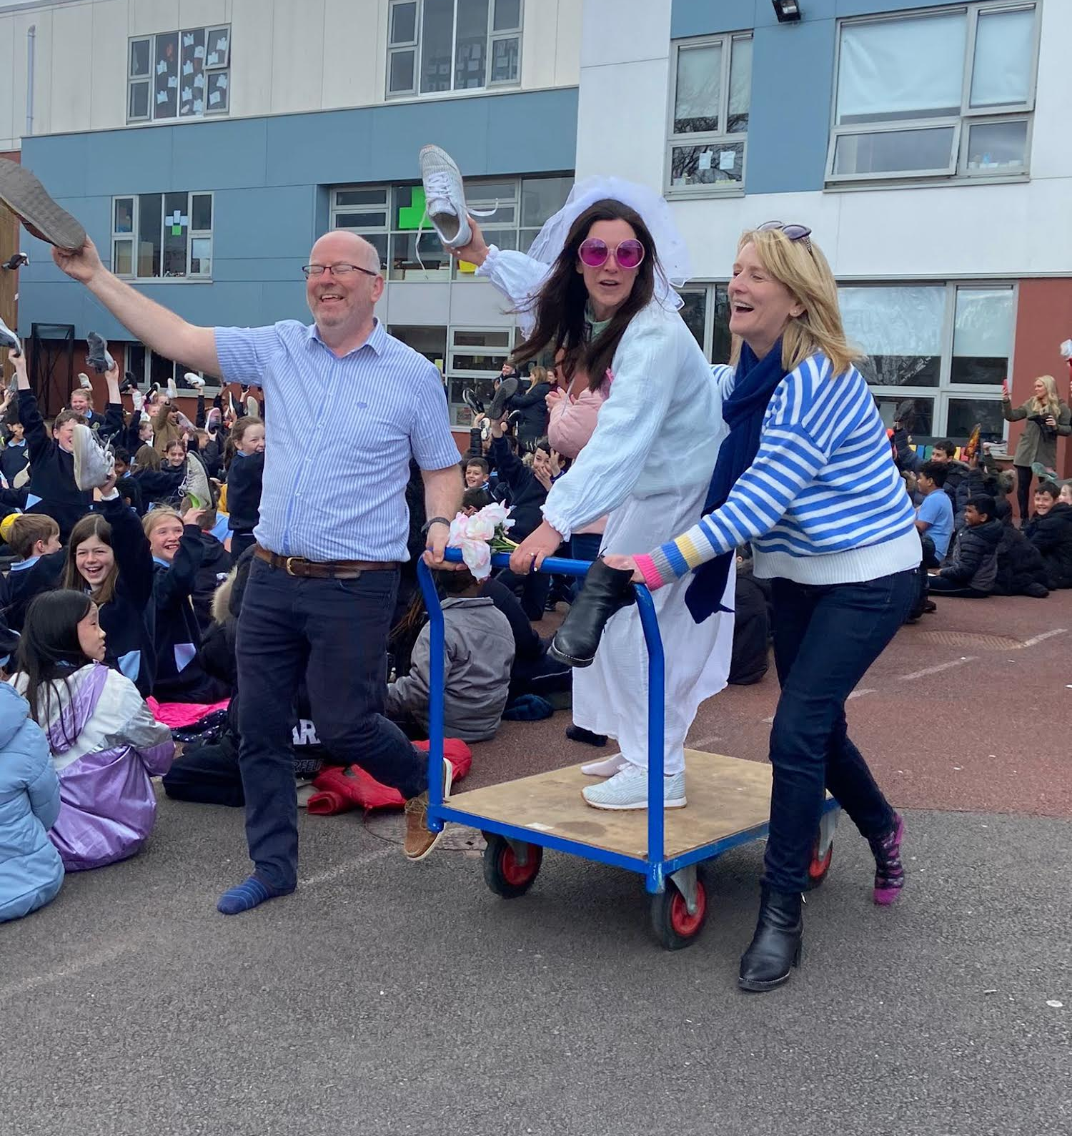
Well-Being as a Whole School Endeavor
The social committee's role in fostering well-being through events.
The evolution towards a systematic approach to staff well-being.
The formation and impact of the Well-Being committee.
A 360 -degree perspective on well-being.

Slide 10
Well-Being Initiatives | Menu Board
Scones | Thank Crunchie it’s Friday!
Secret Santa/Summer Santa | Staff Awards and Prizes: Weekly random raffles for valued items (wine, chocolate, duty cover, parking spot).
12 Days of Christmas Raffle | Easter Egg/Surprise (€5 Max)
Coffee Truck & Ice Cream Van School Visit | Staff Breakfast
After School Activities: | Walk in Parks
- Bike Hire & Cycle | - Coffee & Treats
- Step Challenge | - Staff Yoga
- Teachers in Theme: Staff Bright Colours Day | - Extra 5mins of Yard
Wellbeing Friday Afternoon: Encourage staff to leave on time for personal activities. | Staff Book Club
Drop Everything & Dance | Whole School Mindfulness Sessions
Random Acts of Kindness Week
Sausage Rolls Morning

Slide 11
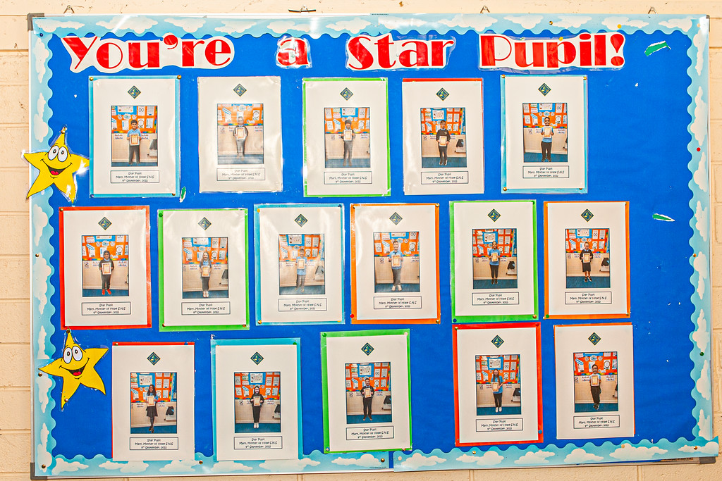
Pupil Well-Being: A Whole-School Approach

Slide 12
Pupil Well-Being: A Whole-School Approach
Healthy Eating

Slide 13
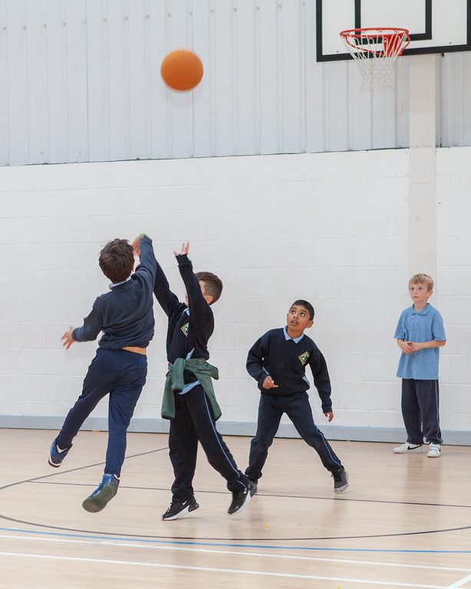
Pupil Well-Being: A Whole-School Approach
Healthy Eating
Physical well-being

Slide 14
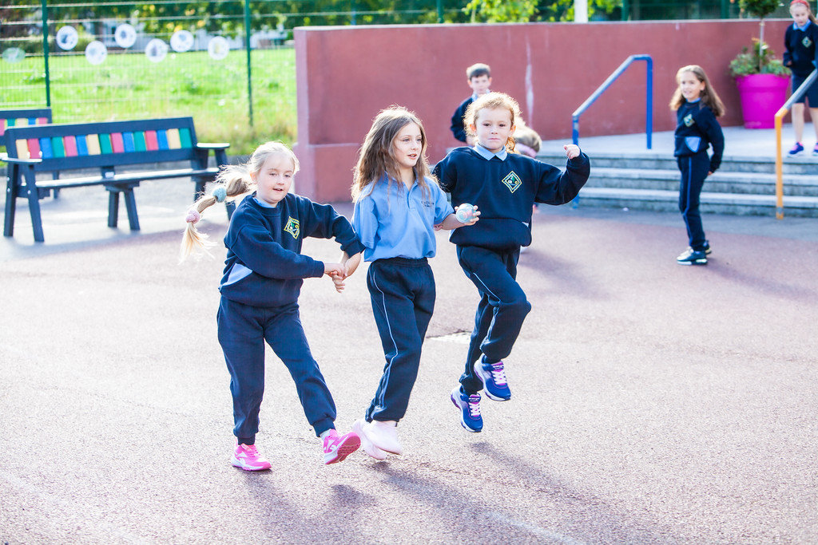
Pupil Well-Being: A Whole-School Approach
Healthy Eating
Physical well-being
An Active School!

Slide 15
Pupil Well-Being: A Whole-School Approach
Healthy Eating
Physical well-being
An Active School!
Drop Everything and Dance!

Slide 16
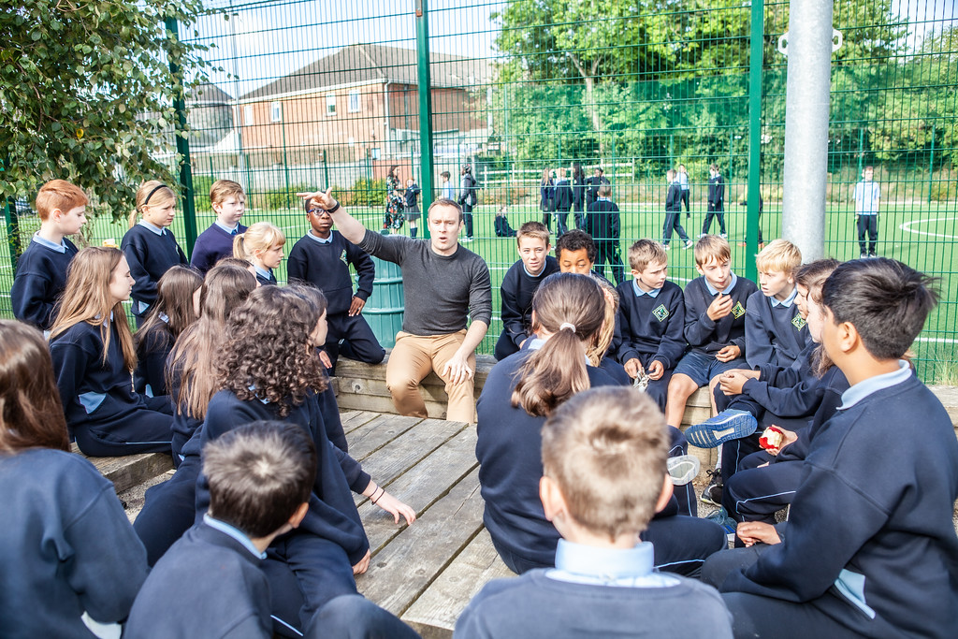
Pupil Well-Being: A Whole-School Approach
Healthy Eating
Physical well-being
An Active School!
Drop Everything and Dance!
Mindfulness
Mental Well-being

Slide 17
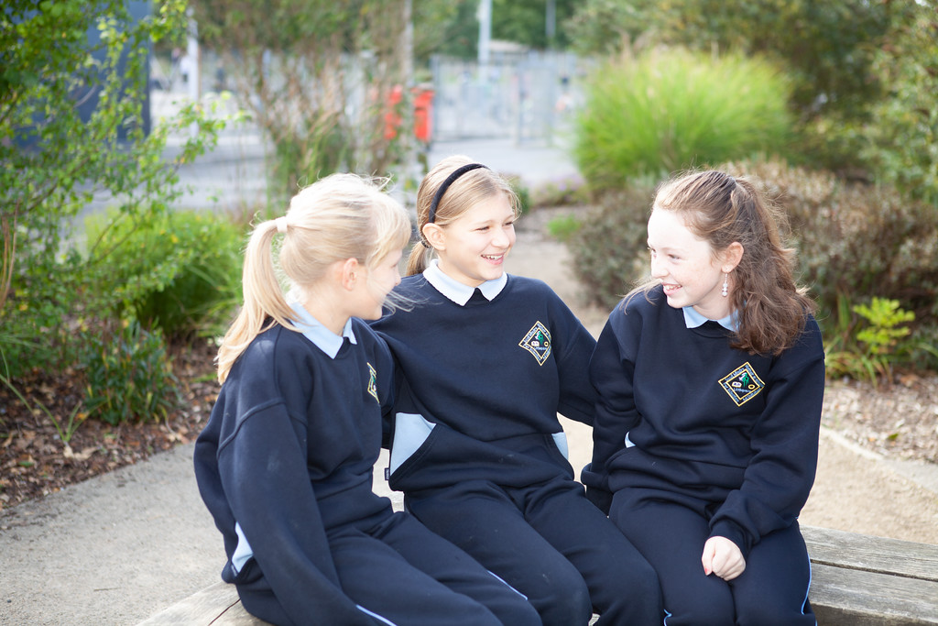
Pupil Well-Being: A Whole-School Approach
Healthy Eating
Physical well-being
An Active School!
Drop Everything and Dance!
Mindfulness
Mental Well-being
Friends for Life Programme

Slide 18
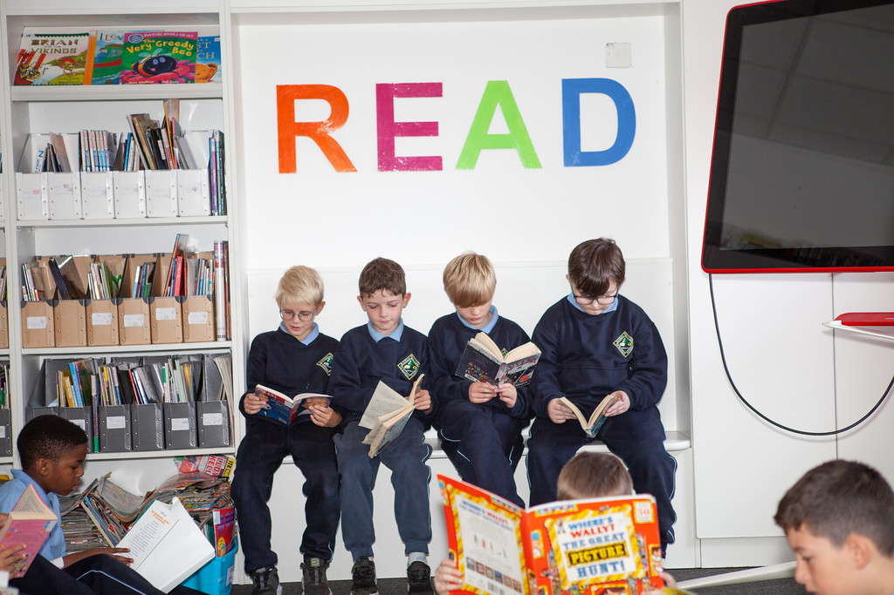
Pupil Well-Being: A Whole-School Approach
Healthy Eating
Physical well-being
An Active School!
Drop Everything and Dance!
Mindfulness
Mental Well-being
Friends for Life Programme
Social Wellbeing

Slide 19
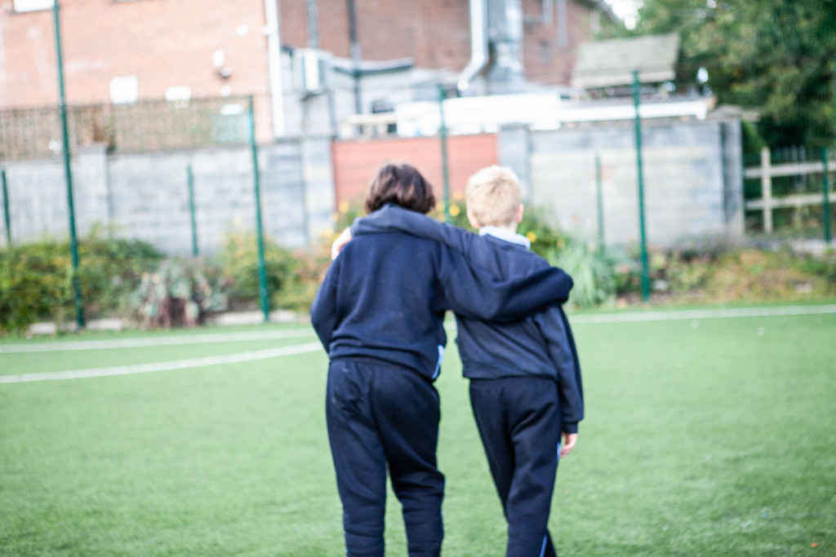
Pupil Well-Being: A Whole-School Approach
Healthy Eating
Physical well-being
An Active School!
Drop Everything and Dance!
Mindfulness
Mental Well-being
Friends for Life Programme
Social Wellbeing
Meeting children where they are struggling

Slide 20
Pupil Well-Being: A Whole-School Approach
Healthy Eating
Physical well-being
An Active School!
Drop Everything and Dance!
Mindfulness
Mental Well-being
Friends for Life Programme
Social Wellbeing
Meeting children where they are struggling:
Hot Chocolate!

Slide 21
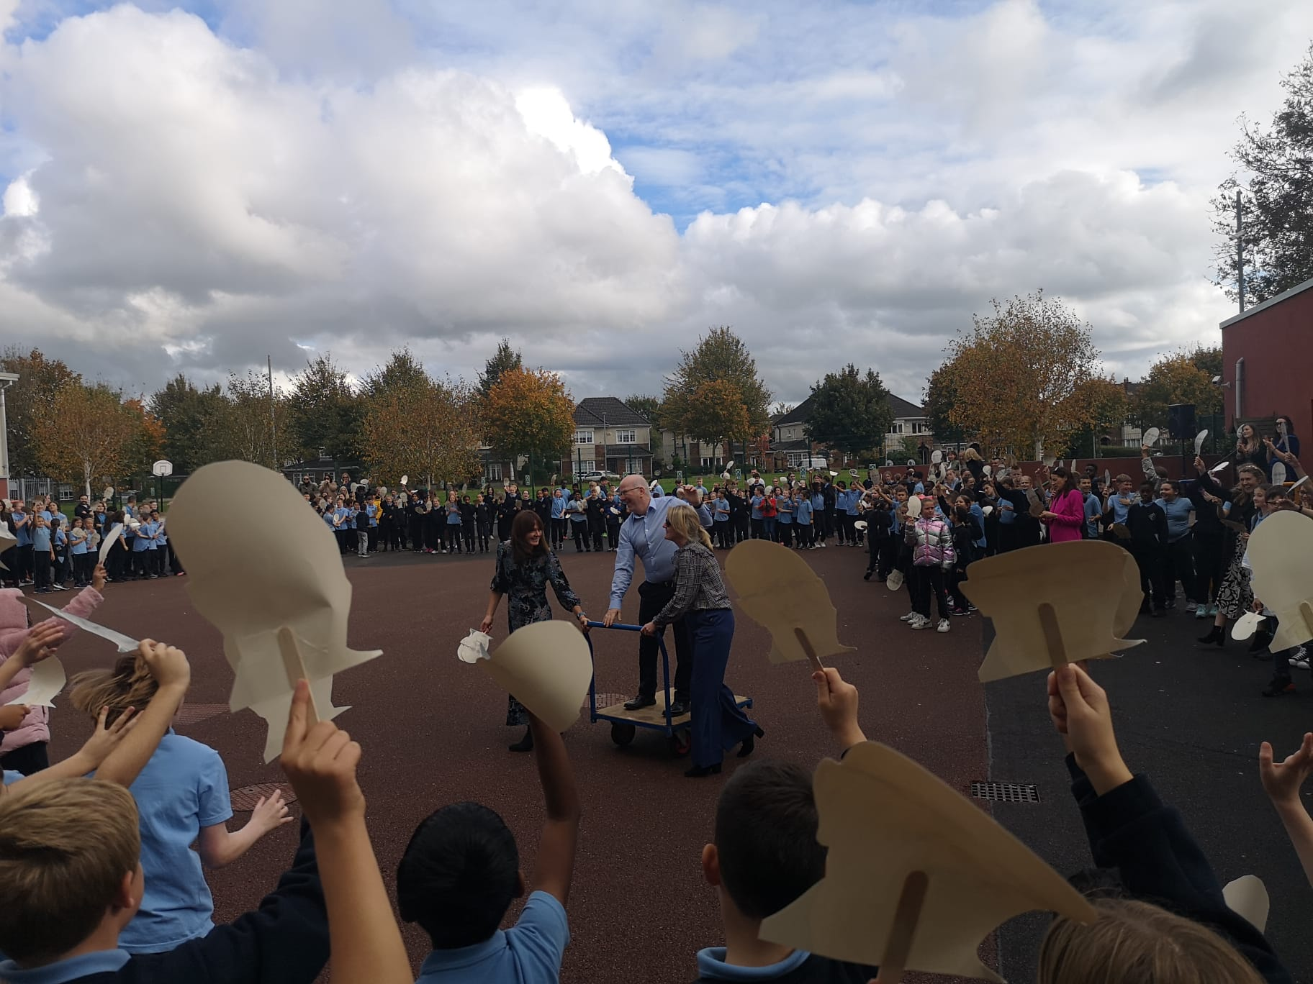
Continued Traditions

Slide 22
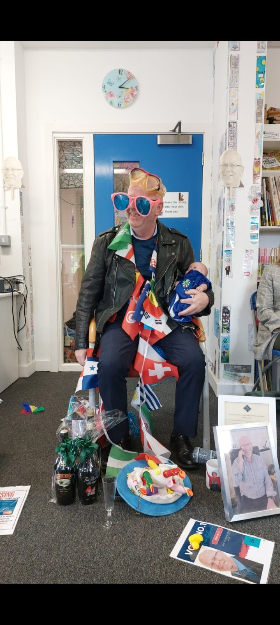
22 years of service……and this is how it ends!!

Slide 23
Míle Buíochas!

